Slide 1
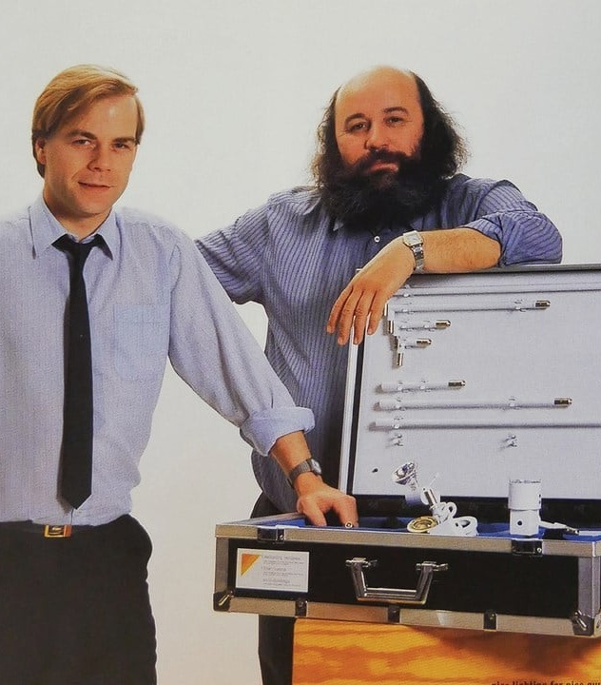
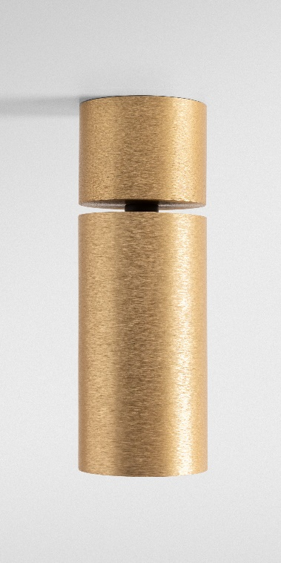
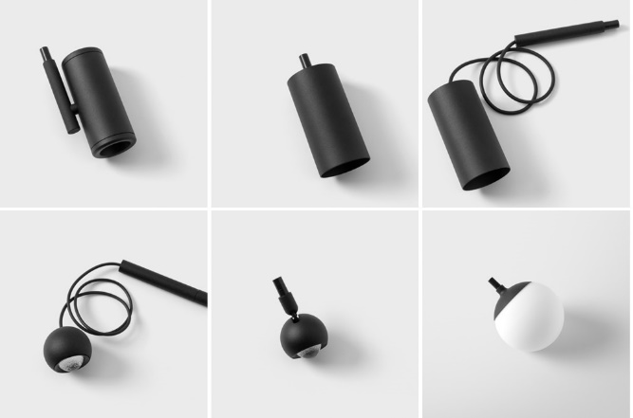
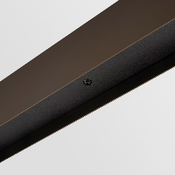
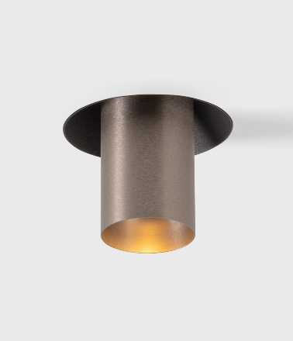
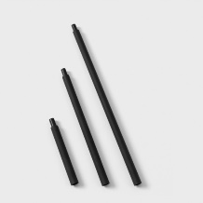
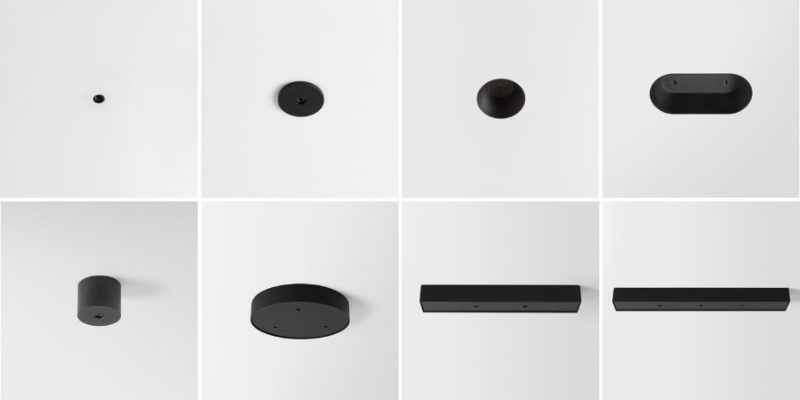
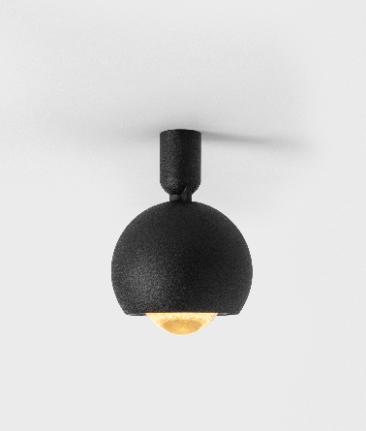
Modupoint
Reason of existence
Miniaturized, versatile platform that enables you to compose building blocks without end regardless the application. Helps you to create a uniform look and feel by using the same spots on wall, ceilings and furniture.
What’s in a name
Original Modupoint was designed by Paul Rommens (founder Modular) in 1984. Known as a true 'modular lighting instrument’: source of inspiration for our company’s name
Key features
A tiny jack connector invites to plug in any of our miniature jack fixtures
Lighting system with interchangeable components
Different mounting solutions to match every application type
Recessed: installation in false ceilings & structural panels
Deep recessed (trimless): driver fits through the cut-out hole; more discrete positioning of the jack luminaires
Recessed trimless: most refined, minimalistic installation
Surface mounted (DI/DE)
Integration in made to measure SLD50 (DI)
Modupoint sticks play with different levels of light
Easy serviceable
Designed by Modular Lighting Instruments

