Slide 1
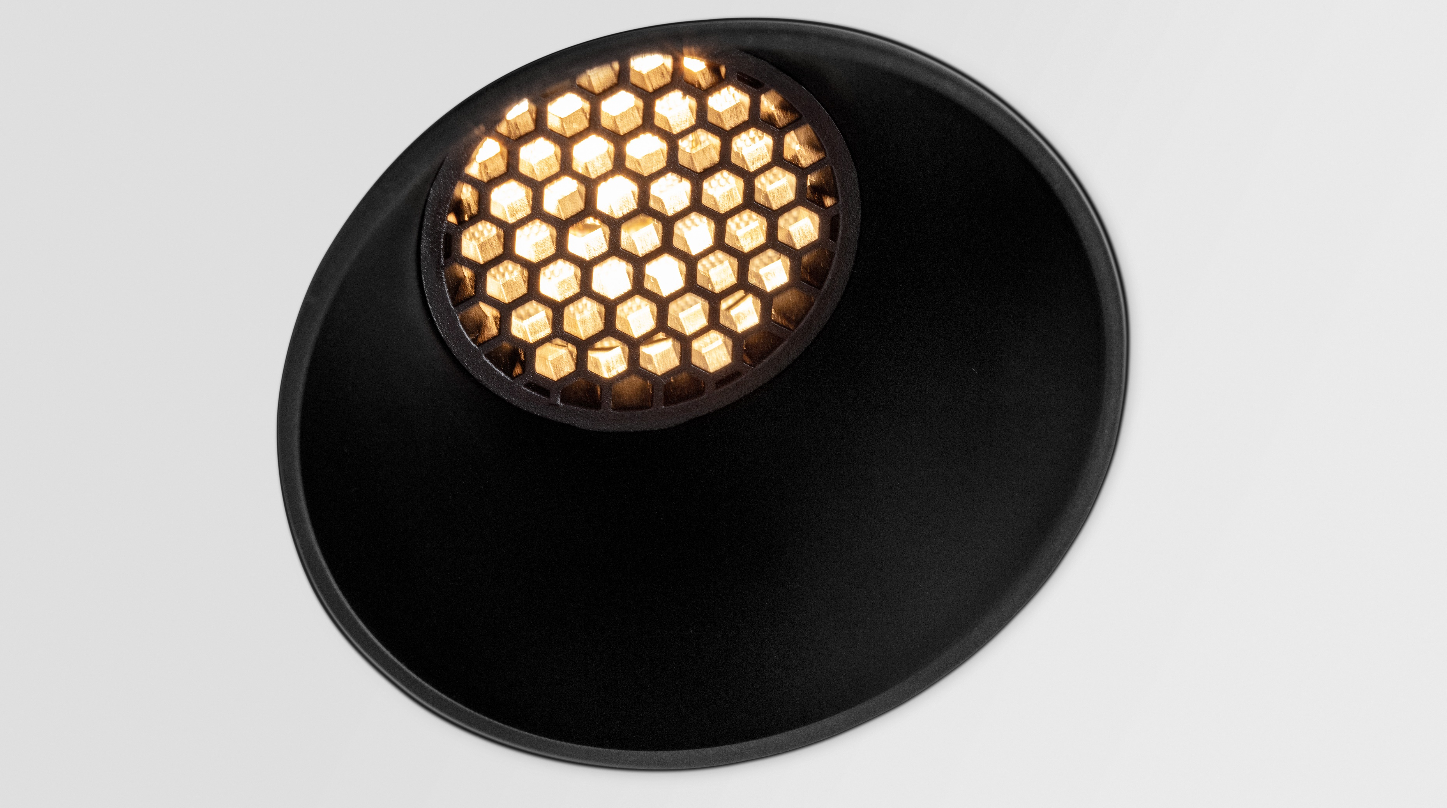
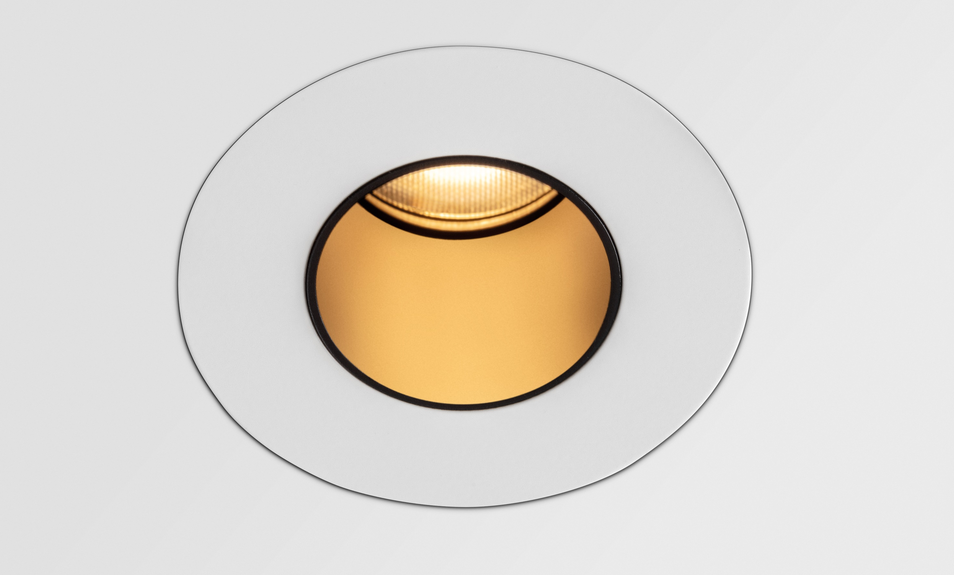
Tetrix
Reason of existence
Accessible but versatile design at competitive price level
What’s in a name
Tetrix refers to the game: playing with pieces, fitting them together in all kinds of intricate ways.
Key features
Cascade of playful design possibilities
5 designs; 2 installation frames; 1 tube; 4 lighting accessories
All aluminum (frames) and polycarbonate (designs/tubes/lighting accessories) components can be clicked into one another interchangeably.
Deep recessed spot for enhanced visual comfort
Gu10 version allows easy smart lighting solution
4 lighting accessories with both anti-glare and esthetical value
Highly efficient polycarbonate TIR lens creates uniform light beam
IP55 rating for all LED dedicated designs; including the adjustable and tube versions
A breeze to install thanks to the extensive range of installation accessories
Easy adjustment of the recessed ring to the desired plaster thickness
Designed by Modular Lighting Instruments

