Slide 1
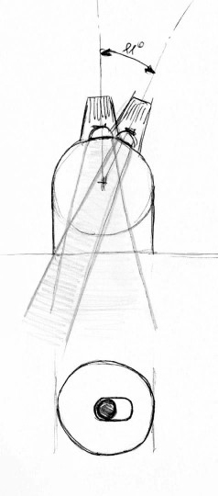
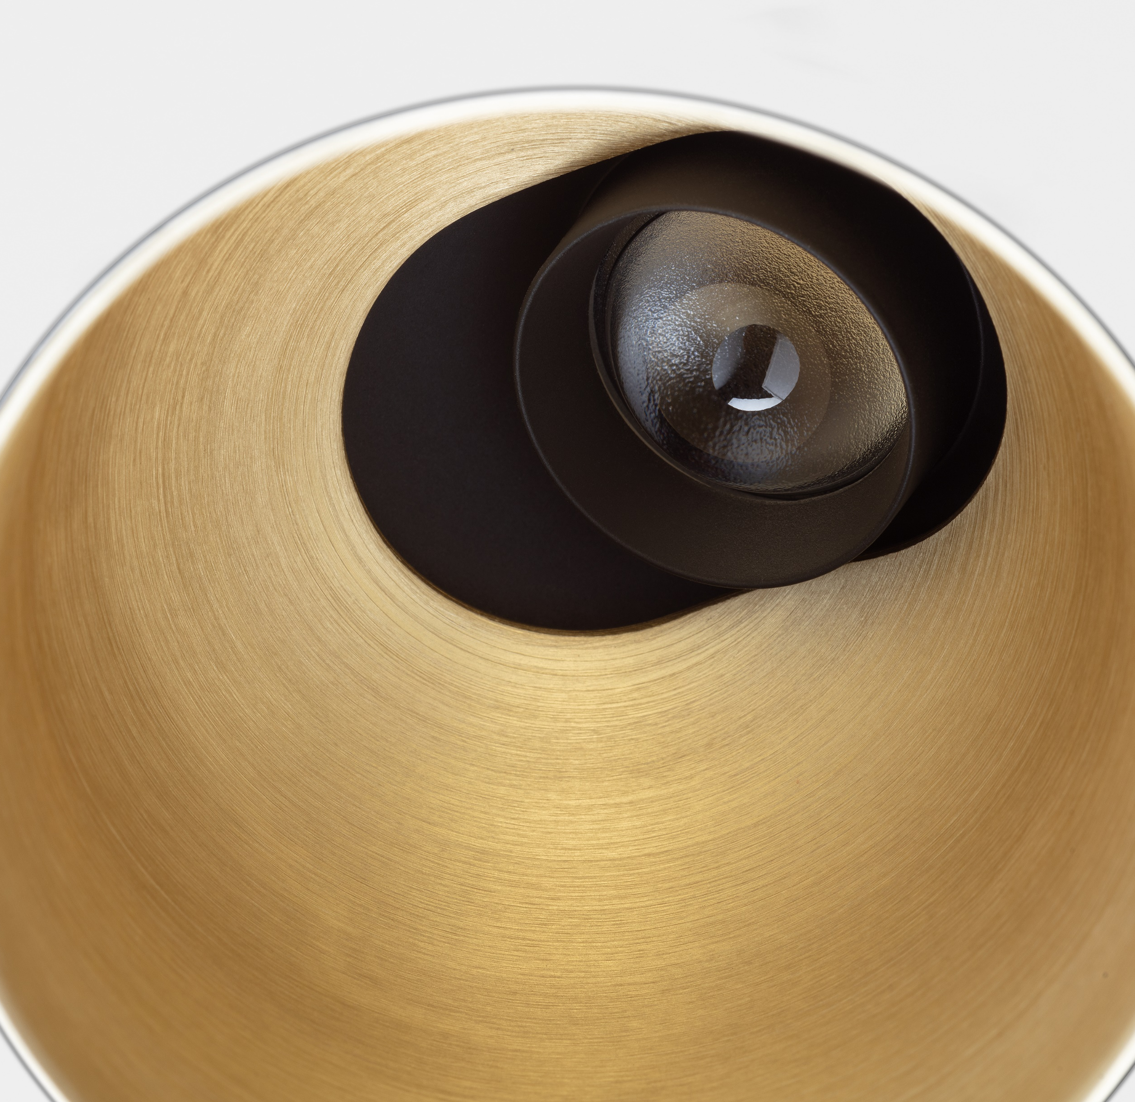
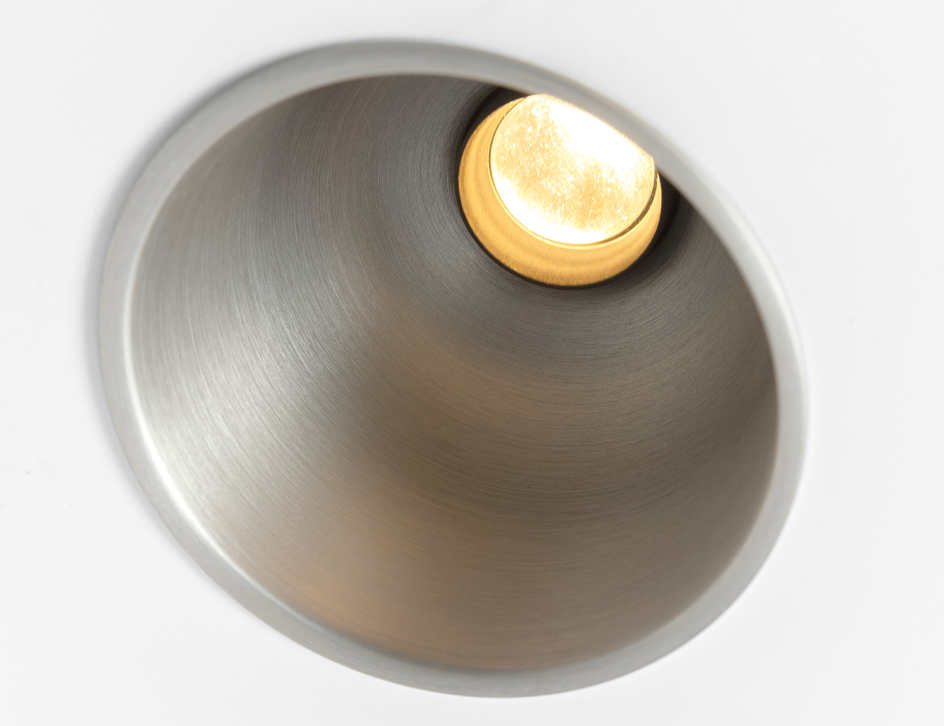
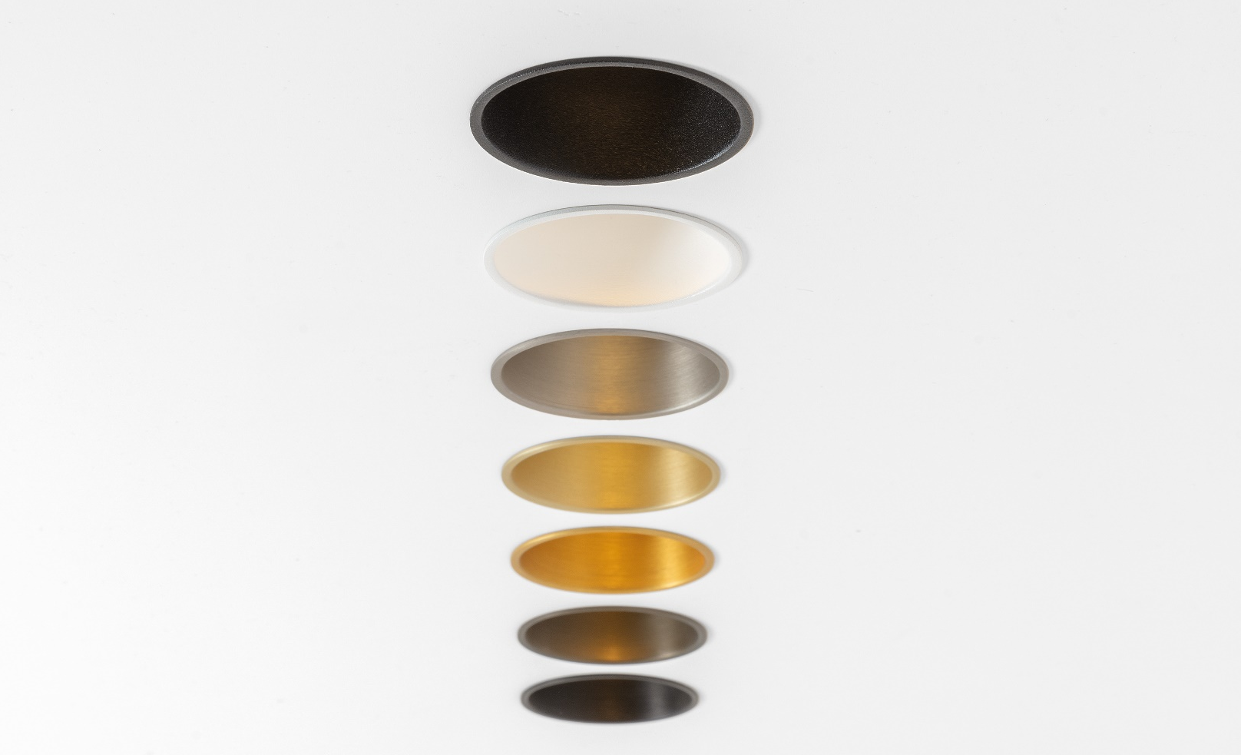
Thimble
Reason of existence
Minimalistic downlight with a discrete light source and sophisticated finishes.
What’s in a name
Thimble refers to a metal cap with a closed end, worn to protect the finger and push the needle in sewing
Key features
Curved, minimalistic shape made of deep drawn aluminum sheet
Ultra thin trim of 3.5mm or trimless
Adjustable: form defined by function. LED module follows the curve of the body. Reducing internal reflection and guiding the light out in an efficient way.
Deep recessed light source: visual comfort
Custom-made aspherical, textured lens → concentrated light beam with soft fade out adding drama and contrast in a room
Glass lens → infinite optical performance
Lens surrounded by thin black collar making it easily adjustable
Slot hole is covered by black cover preventing peeping into the ceiling
Asymmetric heatsink ensures adjustment within cut-out hole
Rich and luxurious look and feel thanks to the brushed anodized sophisticated finishes
Structured powder coated or brushed anodized sophisticated finishes
No installation restrictions: extensive range of installation accessories
Designed by Jeffrey Huyghe

