Slide 1
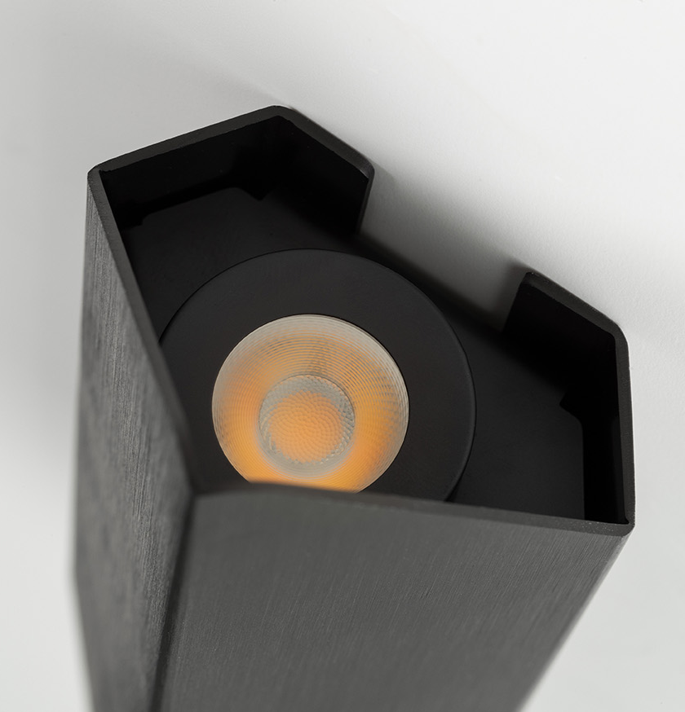
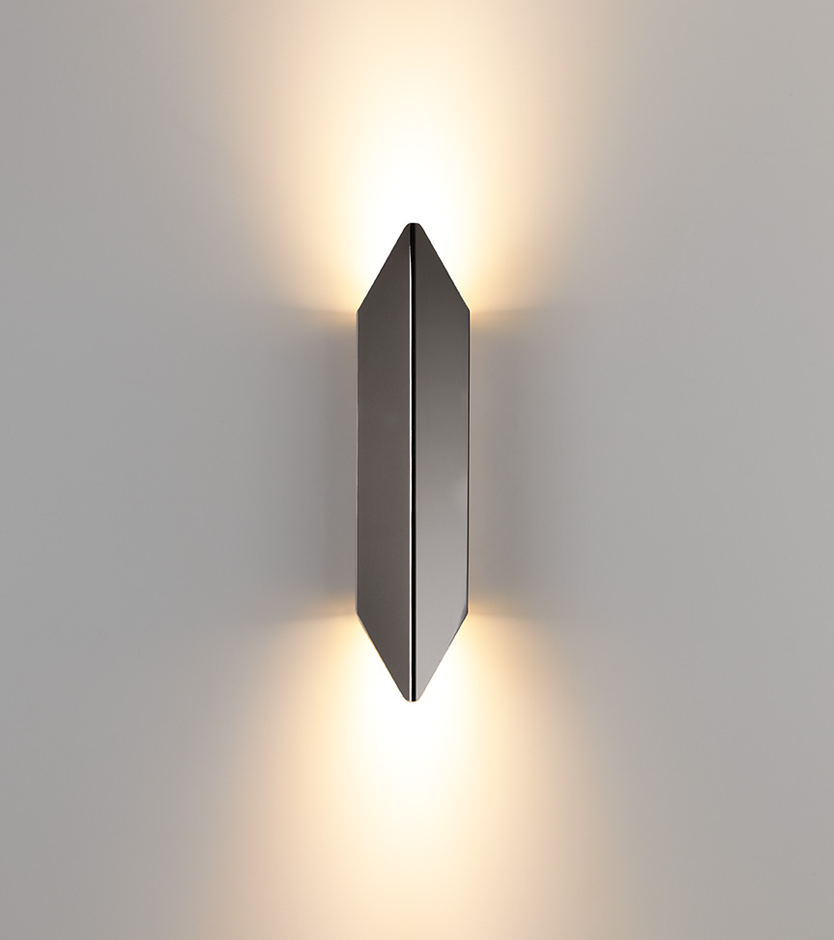
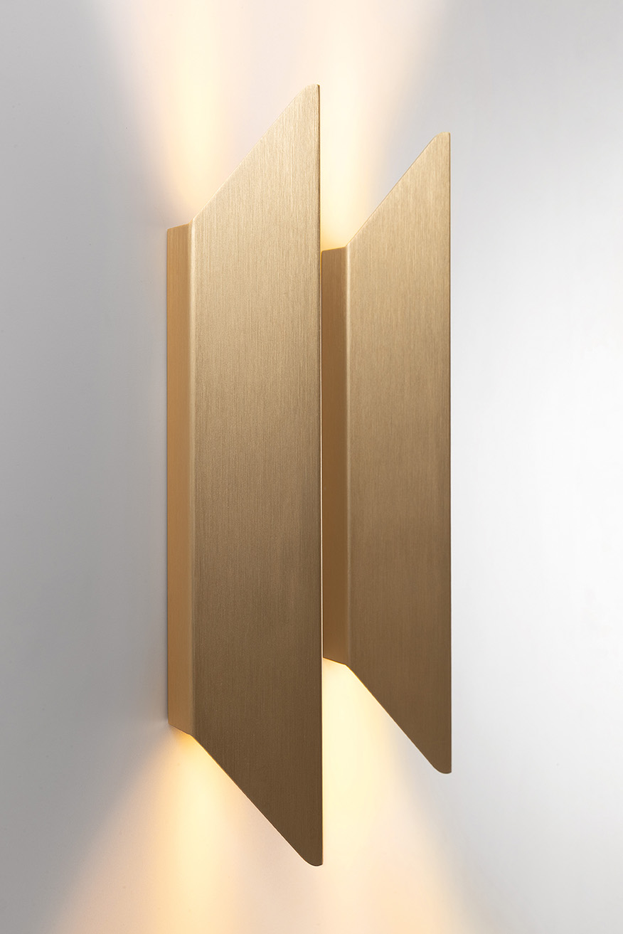
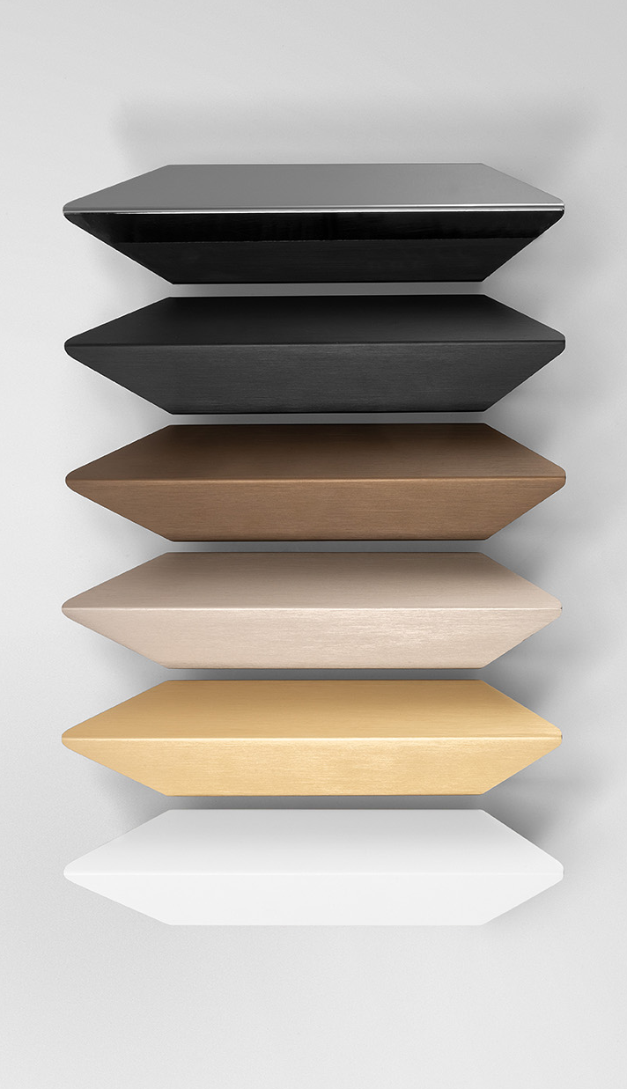
Chival
Reason of existence
An accessible wall luminaire that is characterized by a pure design and sophisticated finishes
What’s in a name
Comes from Chivalry and refers to the traditional historical shield of a chevalier (knight)
Key features
Pure, soft shape made of 1 folded plate
Eye for detail: no visible screws thanks to slide-on housing
Wide range of sophisticated finishes
Grey White Structure – blends with commonly used wall paints
Black Chrome – luxurious reflection of the space
Brushed Anodised – rich and luxurious look and feel
Discretely positioned light sources
Highly efficient polycarbonate TIR lens
creates uniform up & down light beam
strengthens the vertical form of the fixture
Warm dim variant
energizes during the day
creates a warm, cozy atmosphere in the evening
Driver Excluded variant enables savings when multiple fixtures are mounted
Design by Frederik Delbart (BE)

