Slide 1
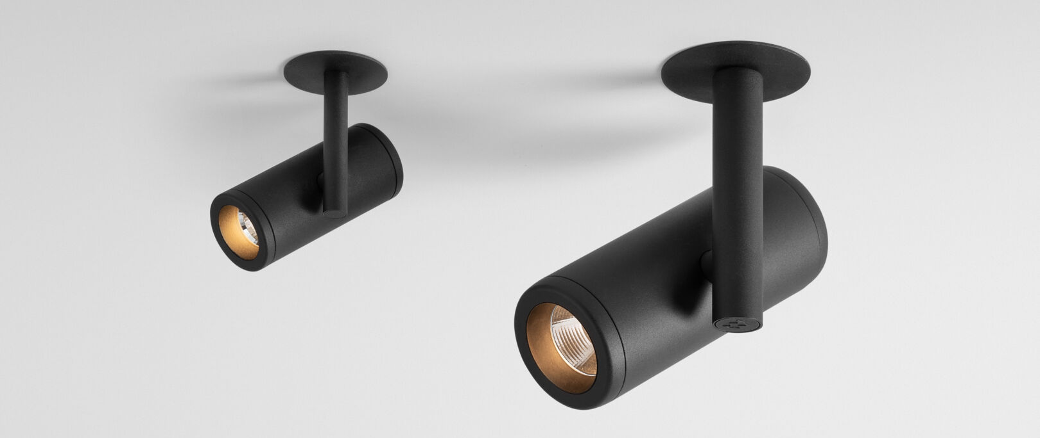
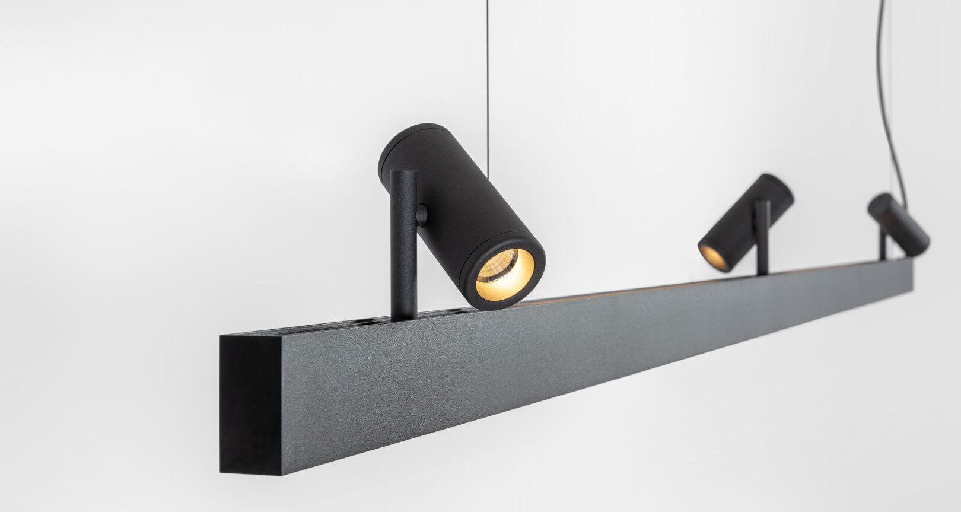
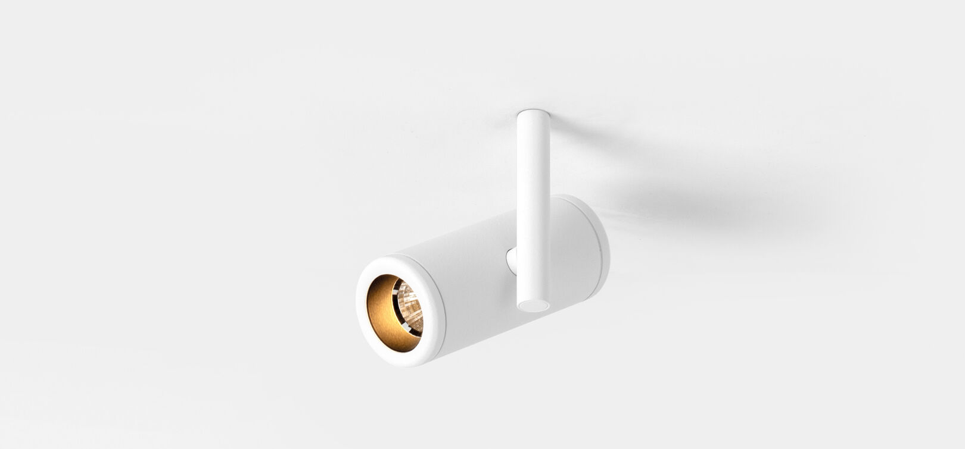
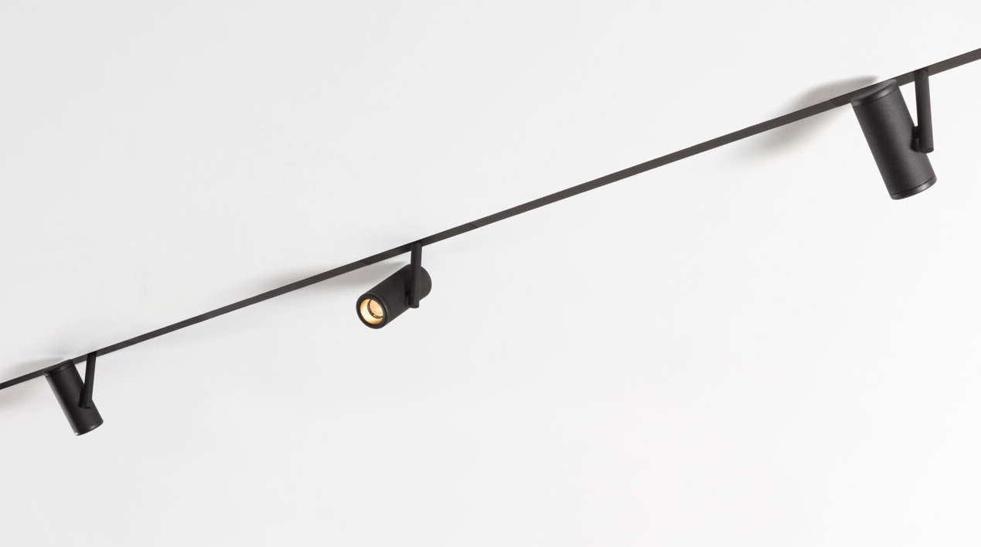
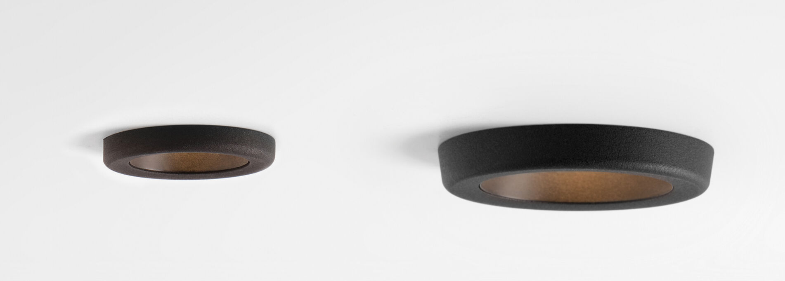
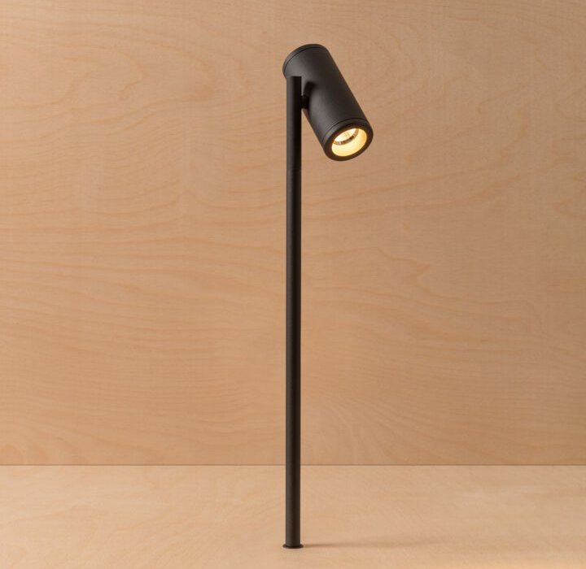
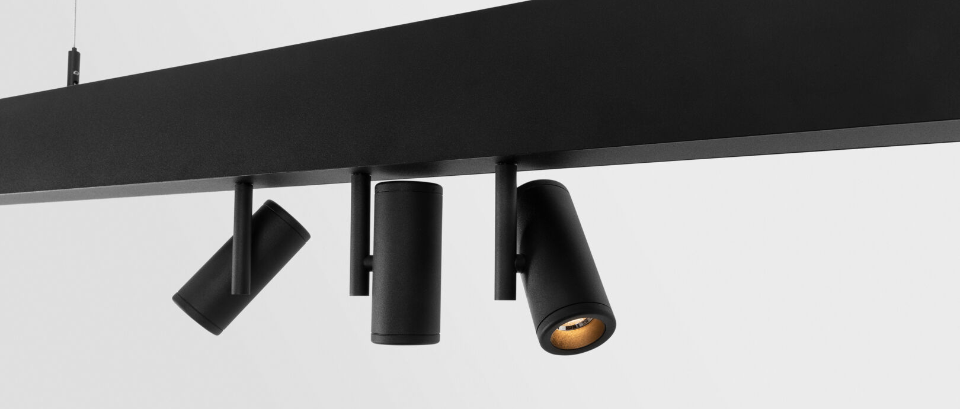
Medard
Reason of existence
Adjustable, cylindrical luminaire that has hardly any limitations in terms of application.
Key features
Rounded, accessible design
Powerful lumen package given its compact size
Matt black inner ring ensures optimal visual comfort
Highly flexible h360° v360°
2 sizes, 2 outputs
Broad application field by different variants:
Semi-recessed
Recessed
Surface DI
Jack
Track 230V | 48V
Designed by Basten Leijh

