Slide 1
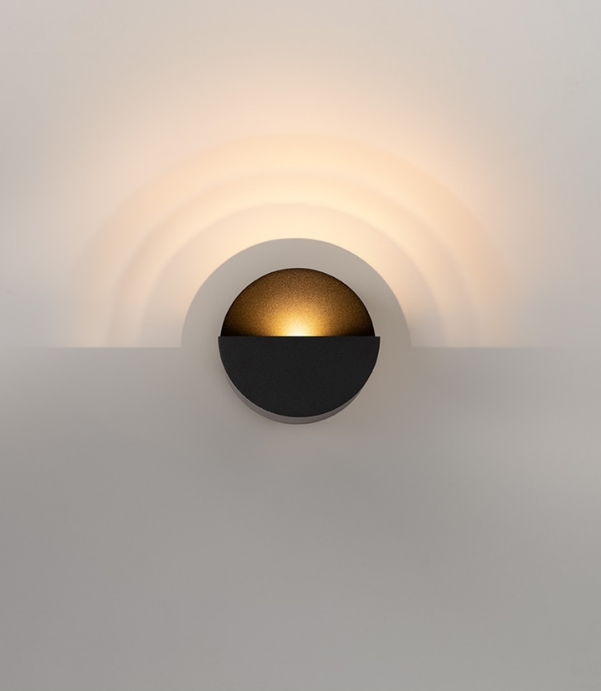
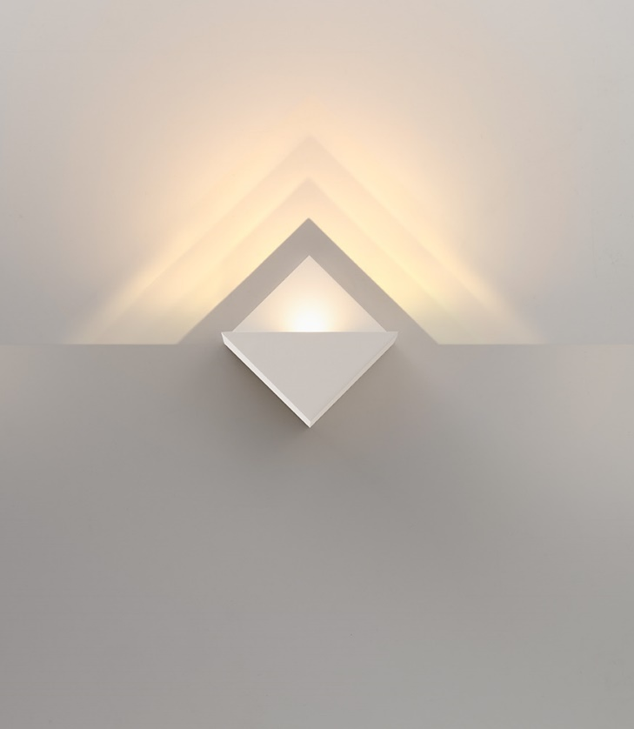
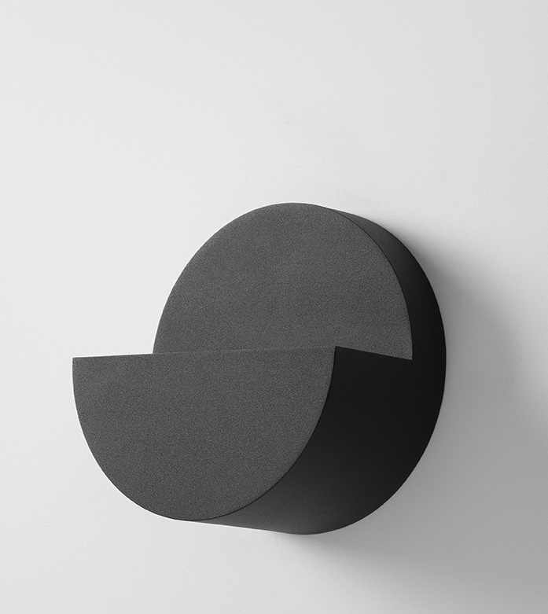
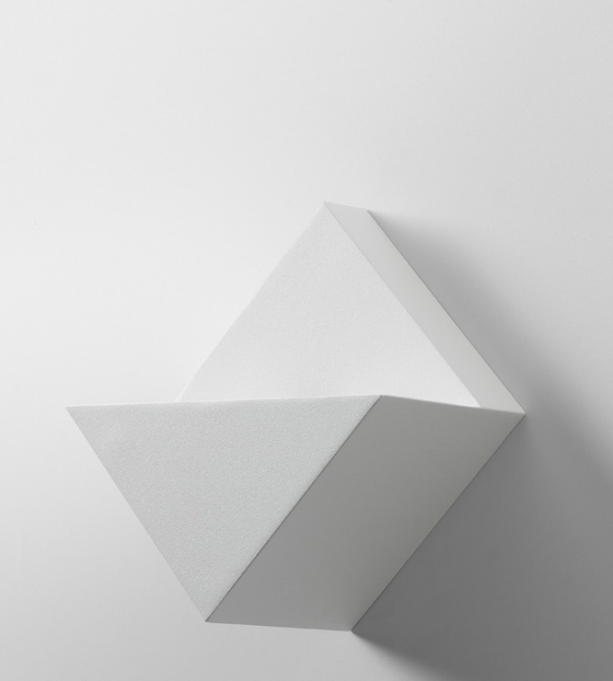
Impulse
Reason of existence
Ode to the very essence of illumination by creating a dialogue between light and shadow
What’s in a name
Refers to a rhythmic pulsing light effect
Key features
2 monolithic shapes that become poetic pieces as they are turned on
Gradient of shadows on the wall mimic the round or square designs
4 meticulously positioned LEDs cast the ripples of light equally
Razor-sharp edges delineate the shadow lines on the wall
Black LED PCB is covered by a transparent parylene coating
Protects against dust and facilitates cleaning
Driver Excluded variant is IP54 rated → use in humid spaces
Structured powder painted finishes
Black Structure
Grey White Structure – blends with commonly used wall paints
Magnet mounting for easy installation
Discrete fixation screw for theft-protection
Driver Excluded variant enables savings when multiple fixtures are mounted
Design by Maarten De Ceulaer (BE)

