Slide 1
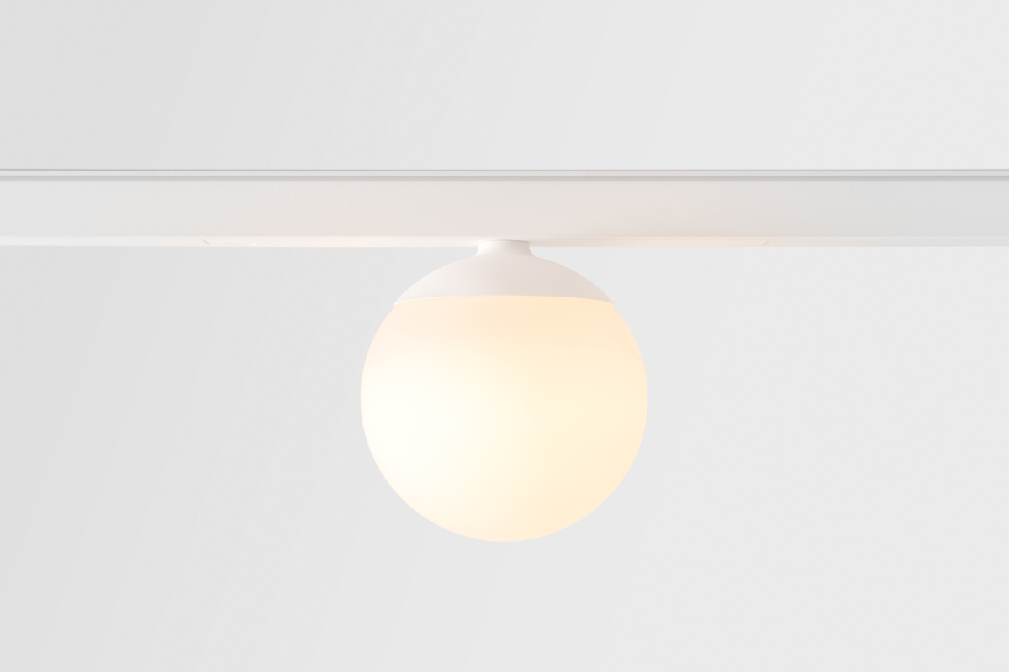
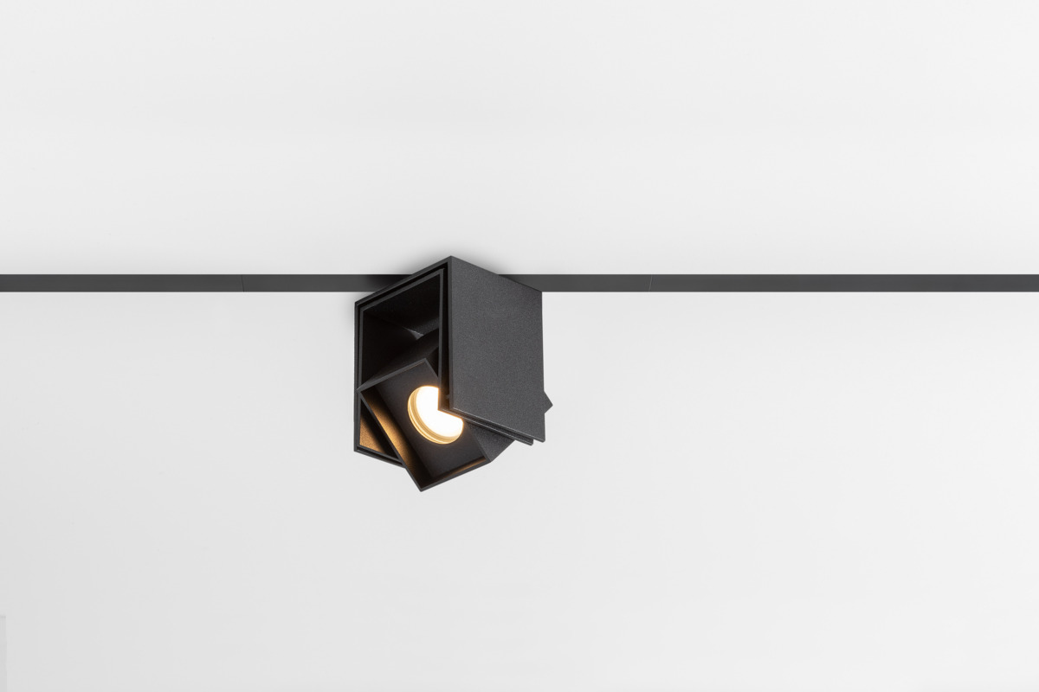
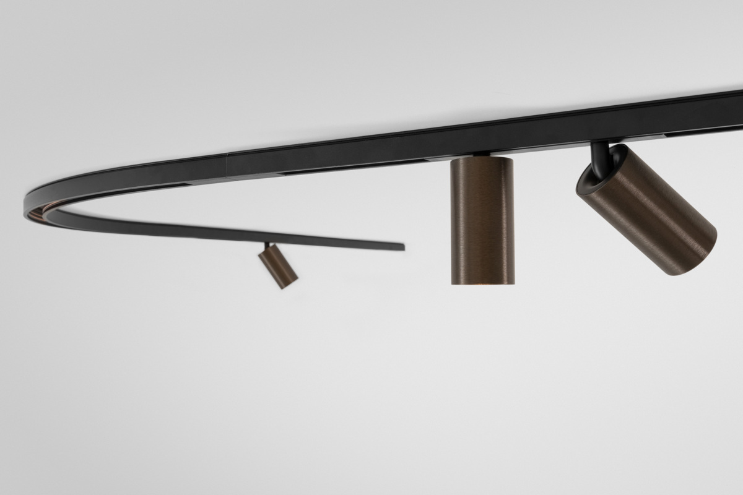
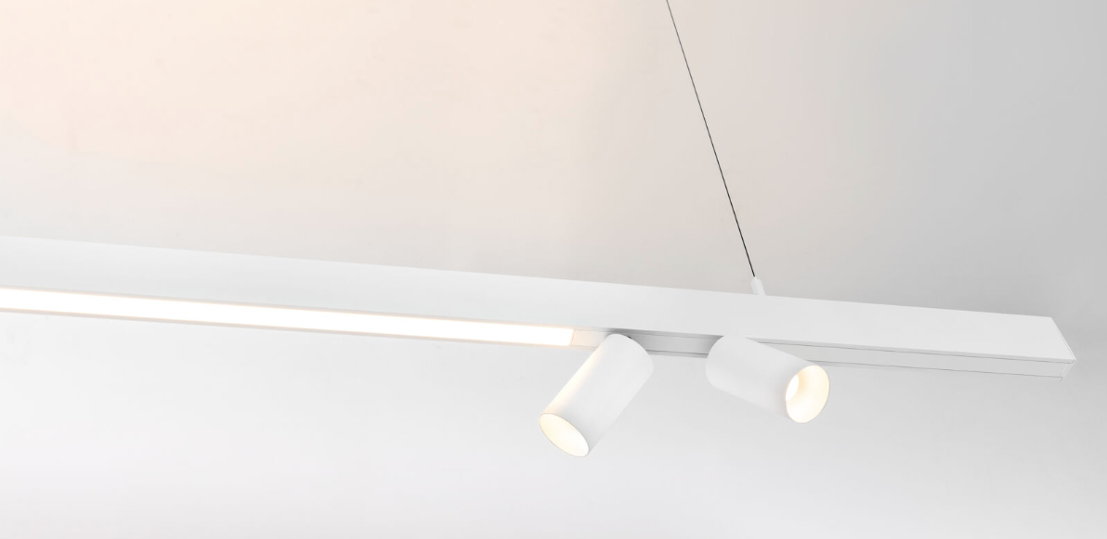
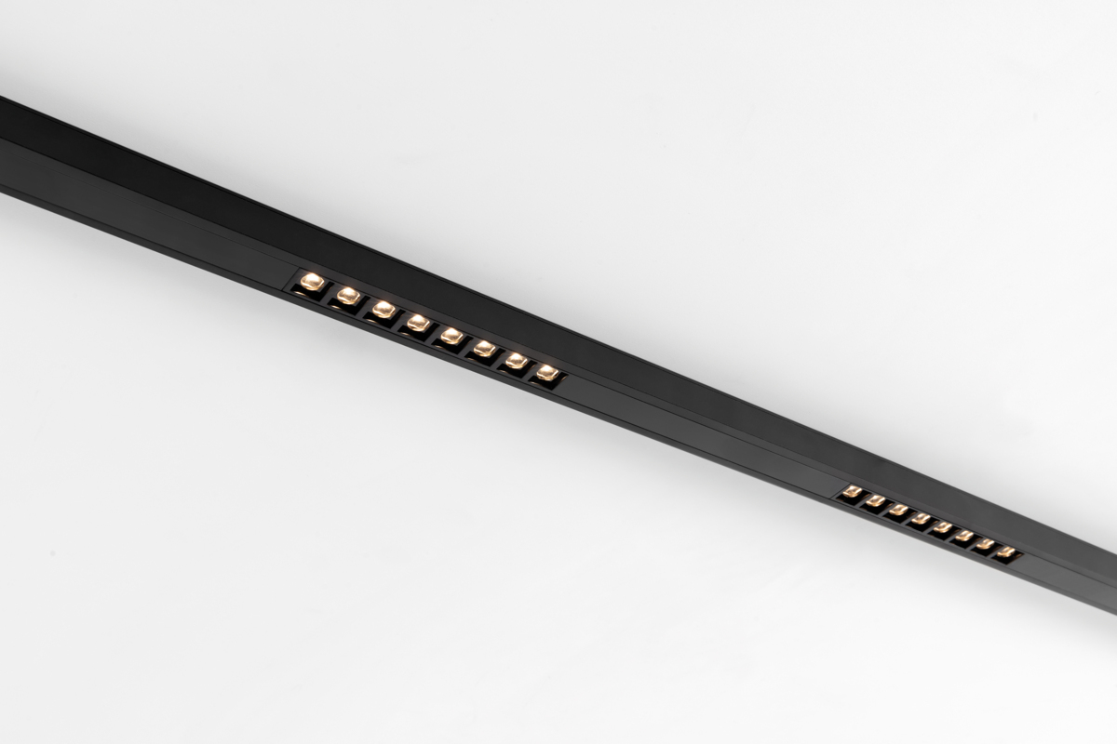
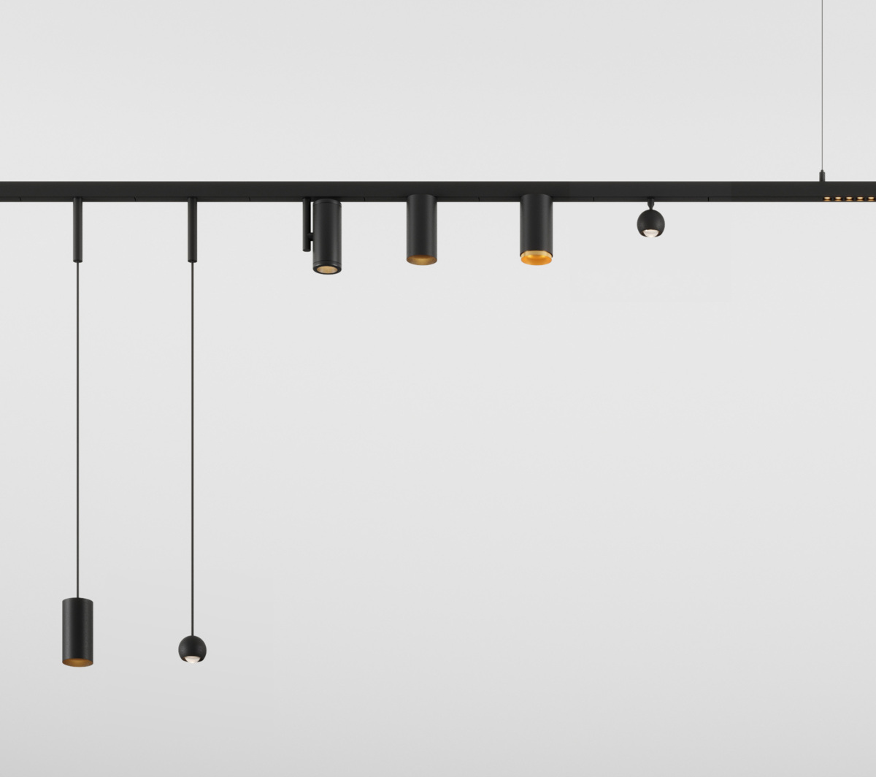
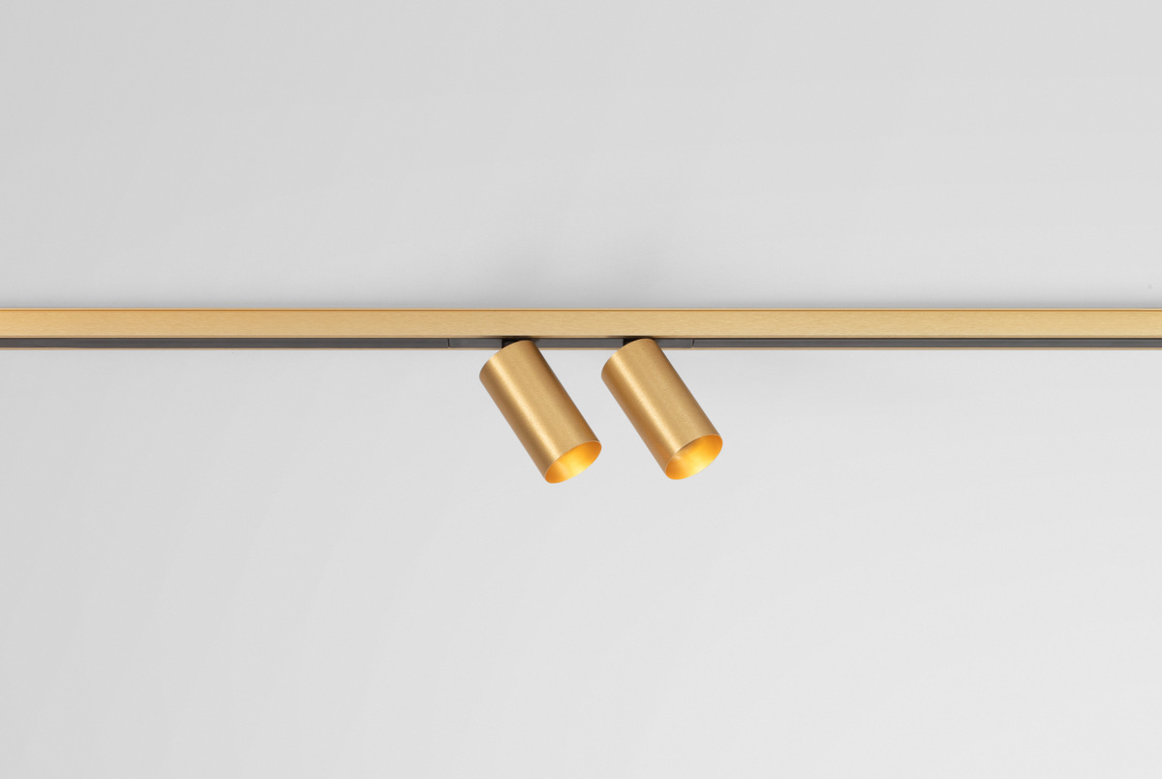
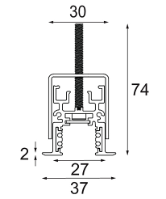
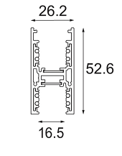
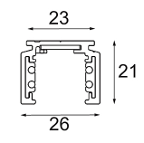
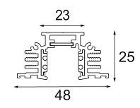
Track 48V
Reason of existence
Slender, refined low voltage track system that lets you play with general and accent lighting starting from one electrical connection and easily adapt the configuration
Key features
Miniaturization: thin and slim track system (26mm)
Different mounting solutions to match every application type: ceiling or wall – surface, recessed (trimless), suspended (down and/or up lighting)
Powder painted and brushed anodized finishes to match the track
Allows for creative configurations by using different connectors: 180°, 90° , flexible connection; 90° and 135° curved connection
Clean blind covers to hide all technical aspects
Endplates without visible screws
Painted suspension kits with ultra thin black steel cables, black matt power feed cable
1-10V or Dali dimmable
Wireless control by Casambi or Hue
Bracket for integration in climate-control ceilings
TRACK 48V
SURFACE
TRACK 48V
RECESSED TRIMLESS
TRACK 48V
RECESSED
TRACK 48V
UP & DOWN

