Slide 1
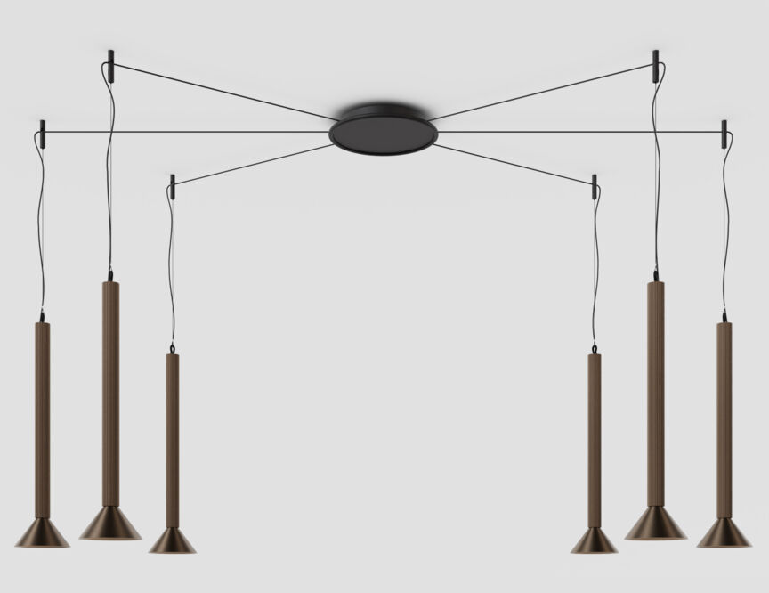
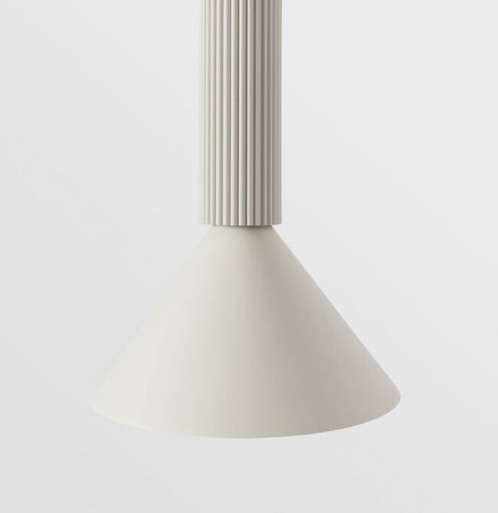
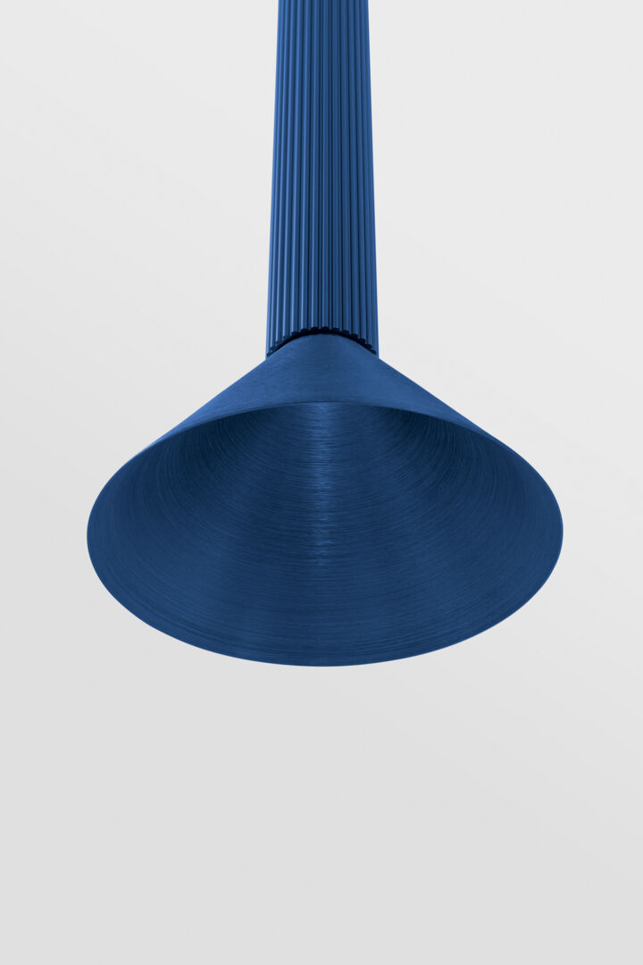
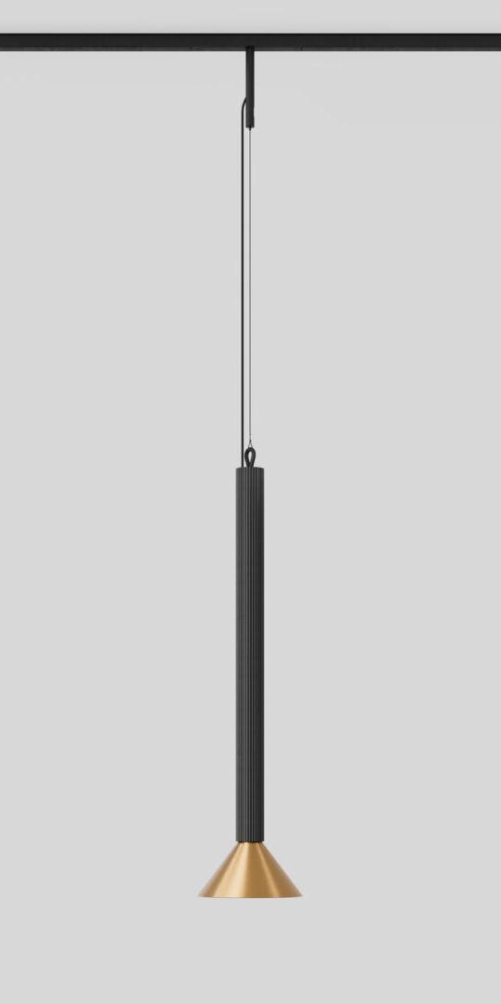
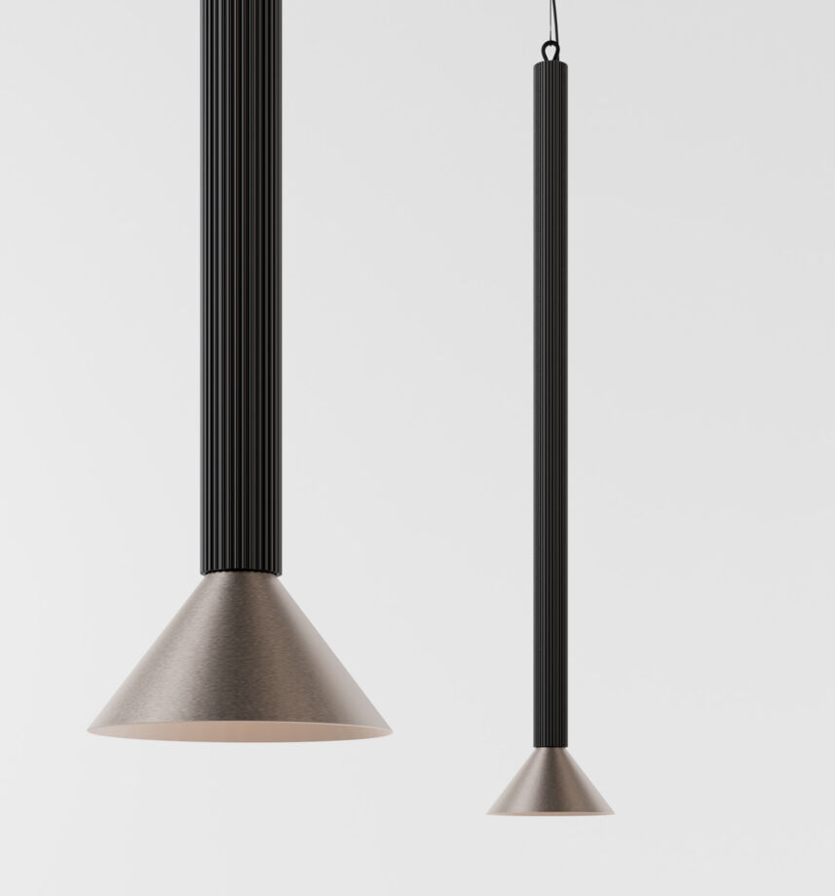
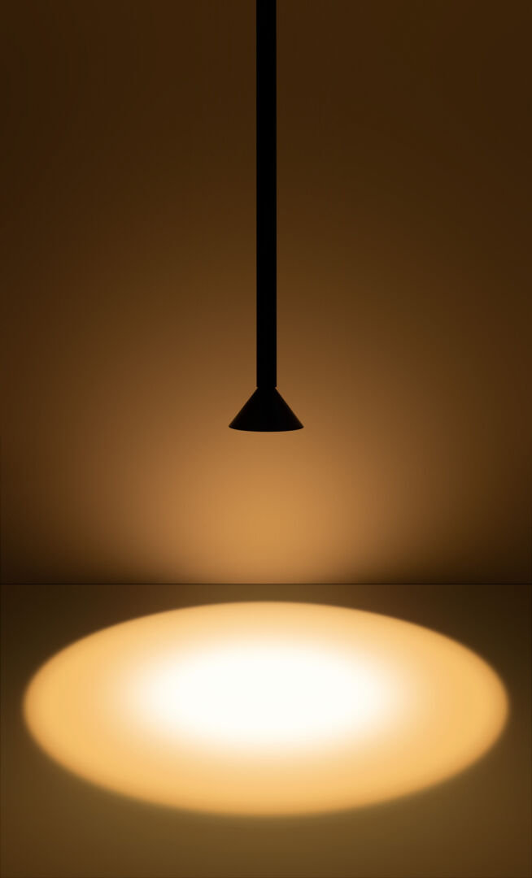
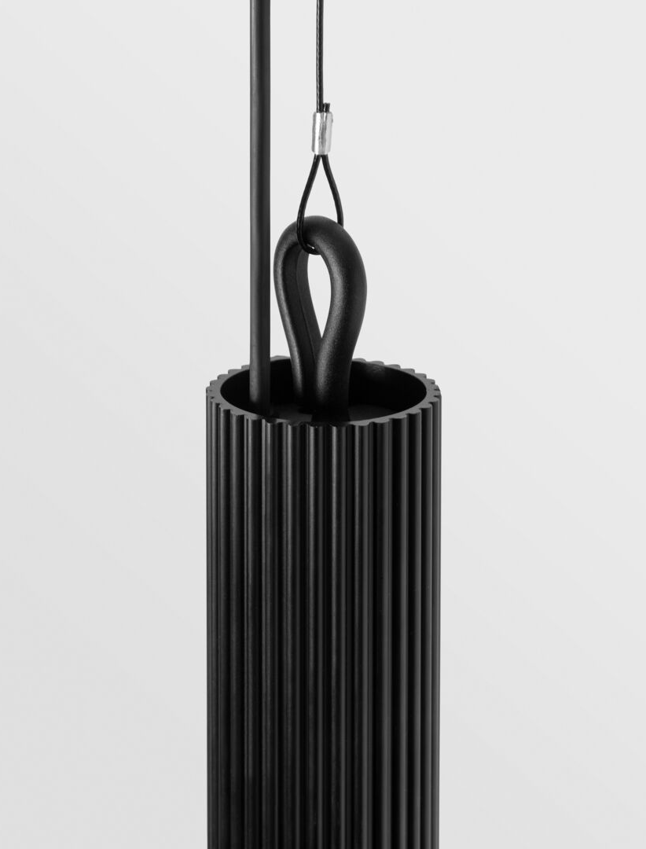
Extruded
Reason of existence
A cone-shape pendant that offers glare-free, intimate, accent light. Strong lines to bring vertical structure to your space.
What’s in a name
Extruded refers to the ribbed, extruded tube of the luminaire.
Key features
The carefully designed ribs catch light and shadow differently as the hours go by.
3 different lengths: 300 | 600 | 900
create a rhythm by playing with vertical lines
graphic architectural element
A small looped hook at the tip peeks out subtly
Thin black steel cable in combination with a black power feed cable
Conical lampshade offers a well-defined, flood beam of light
Deep recessed light source results in an attractive, glare-free radiance
Extra cosy feeling thanks to warm dim technology
Different installation options:
semi-recessed (DE)
surface mounted (DE|DI)
track 48V
kompas
Many rich anodized colors and a matt grey white finish
Designed by Alain Gilles

