Slide 1
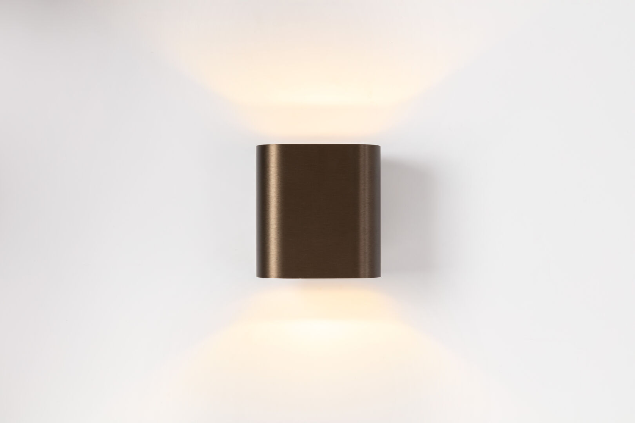
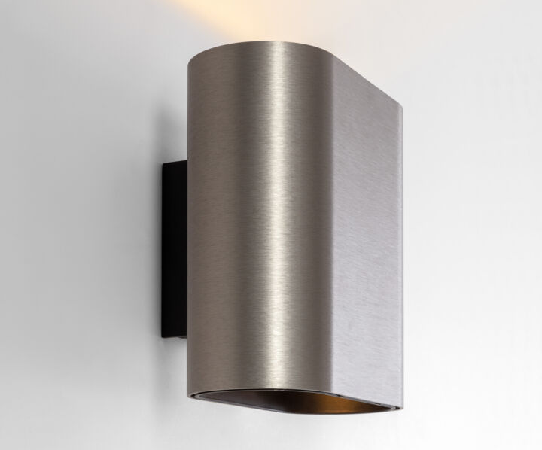
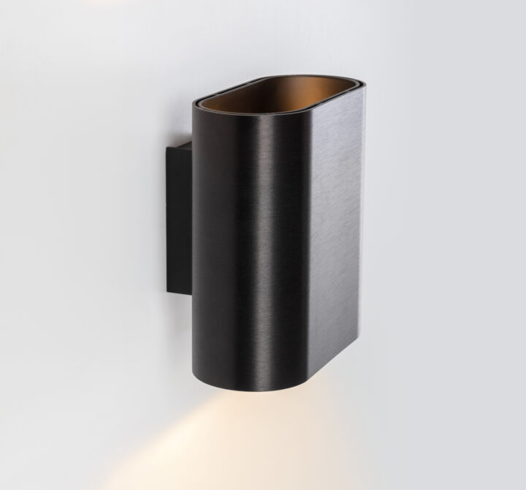
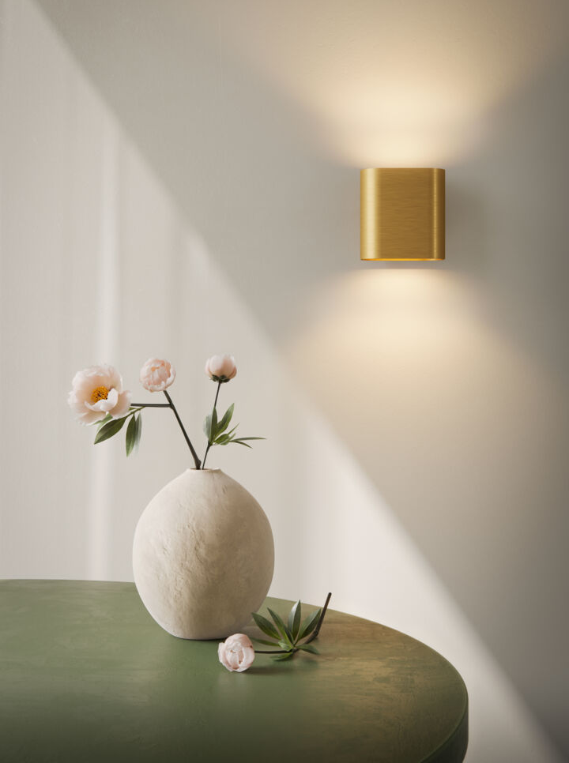
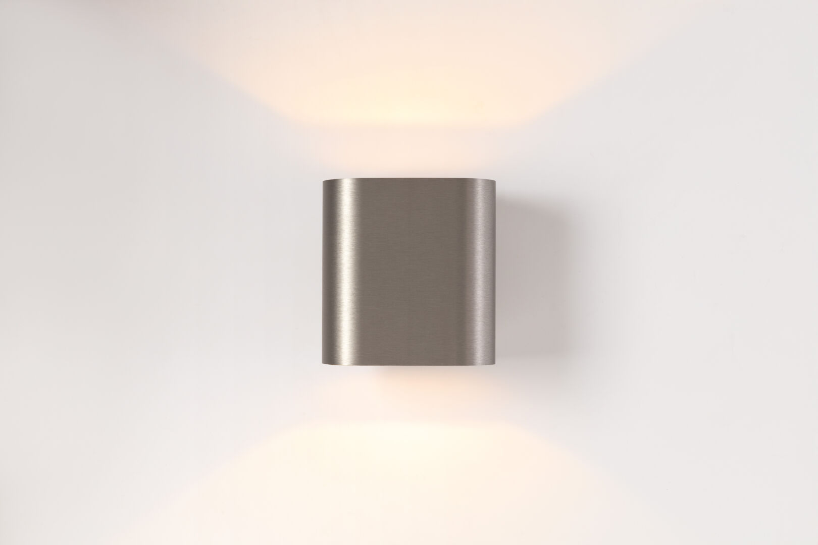
Duell
Reason of existence
A real Modular icon (2004). Duell Wall is a timeless, architectural wall luminaire perfect for bringing a quiet ambience to a space.
What’s in a name
Duell refers to the duality between 2 colors
Key features
Soft, organic shape
Double-walled housing in distinct finishes accentuates the duality of the luminaire
12 different color combinations
Powder painted or brushed anodized
Duell creates a wide fan of up and down light
Connect indoors and outdoors: IP20|IP55 available in same CCT’s
Designed by Modular Lighting Instruments

