Slide 1
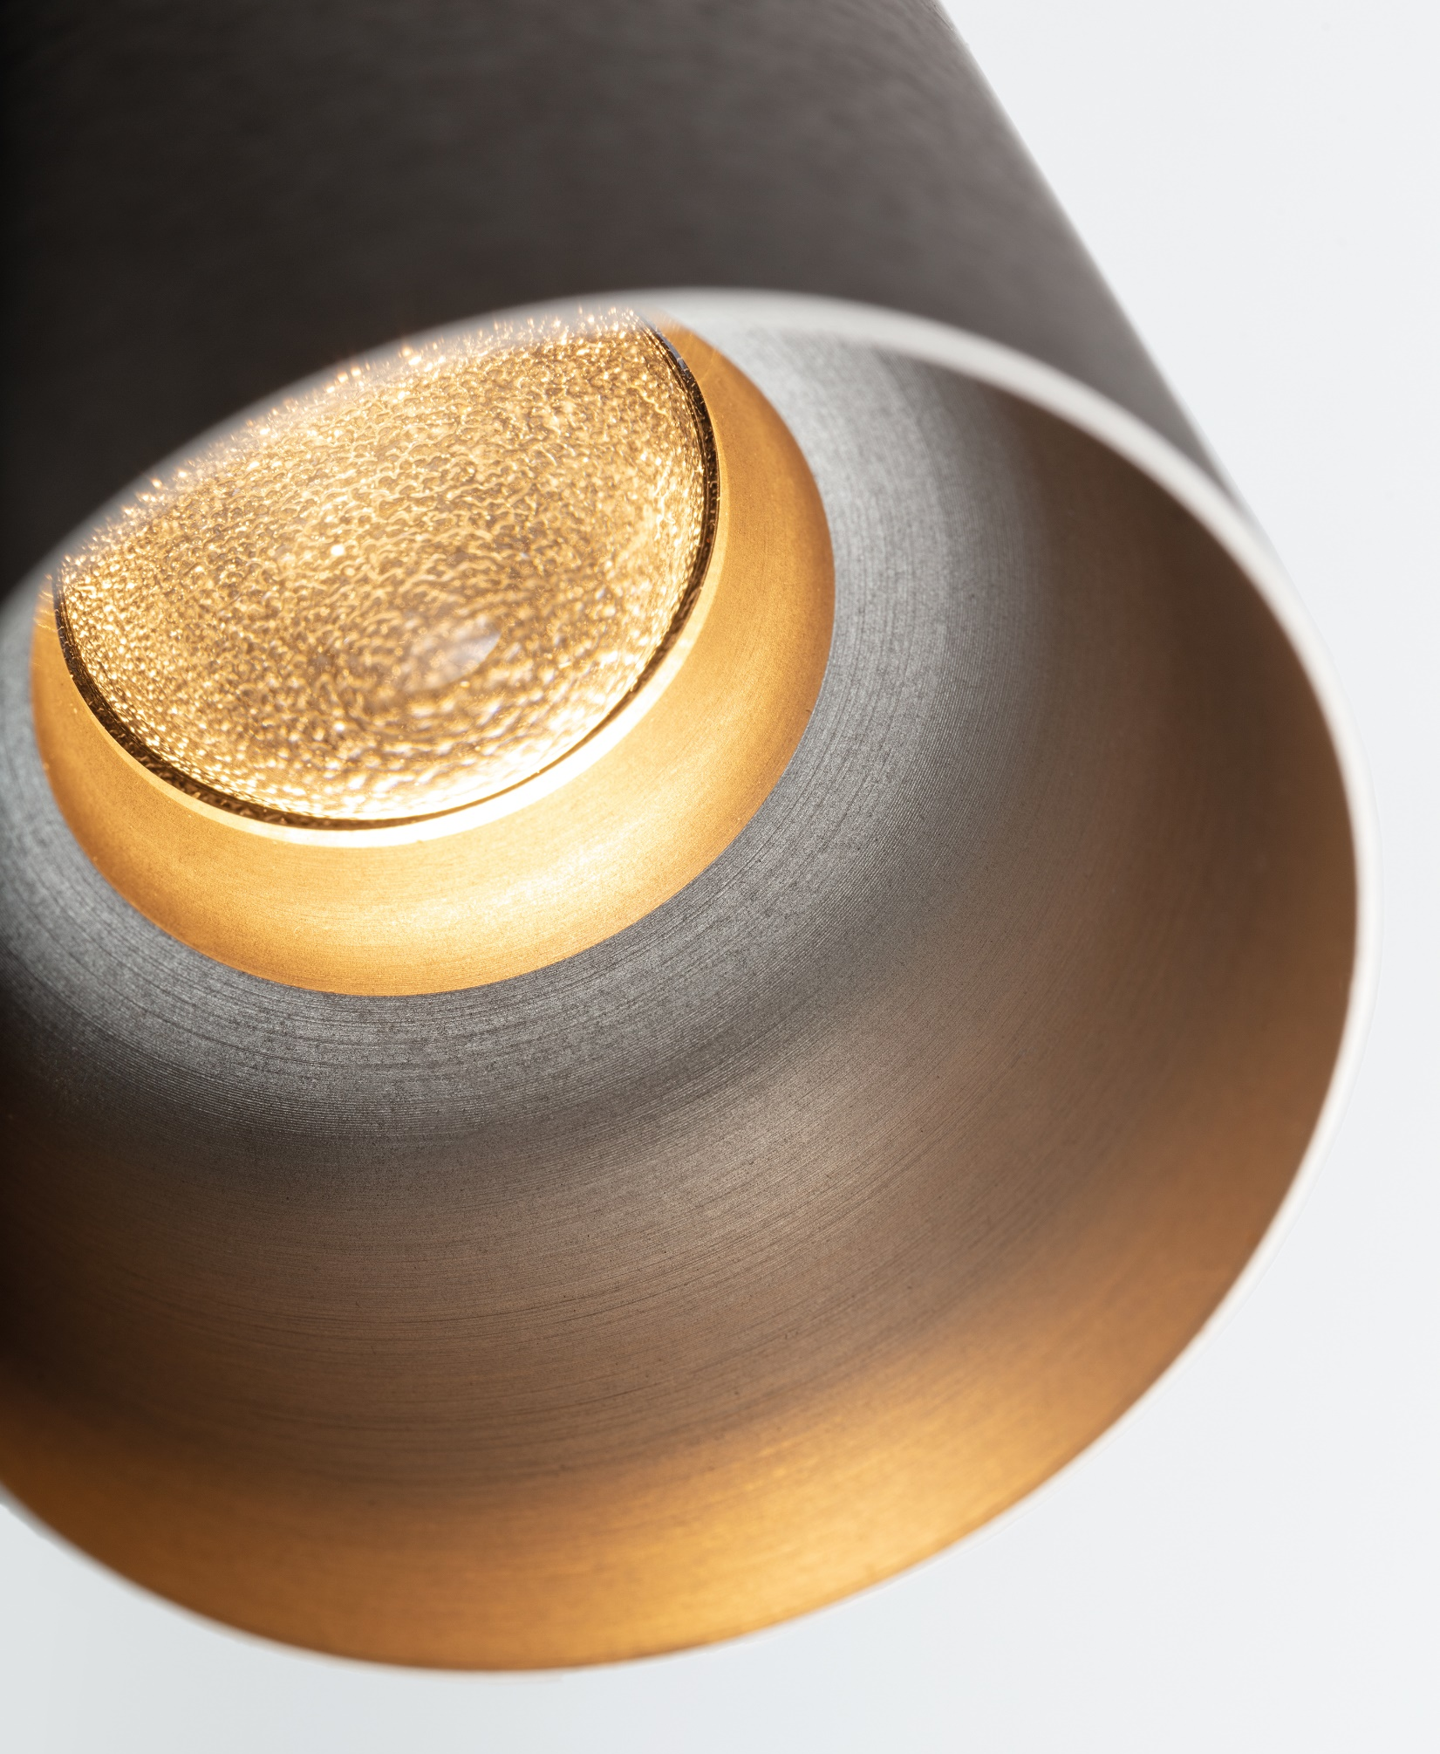
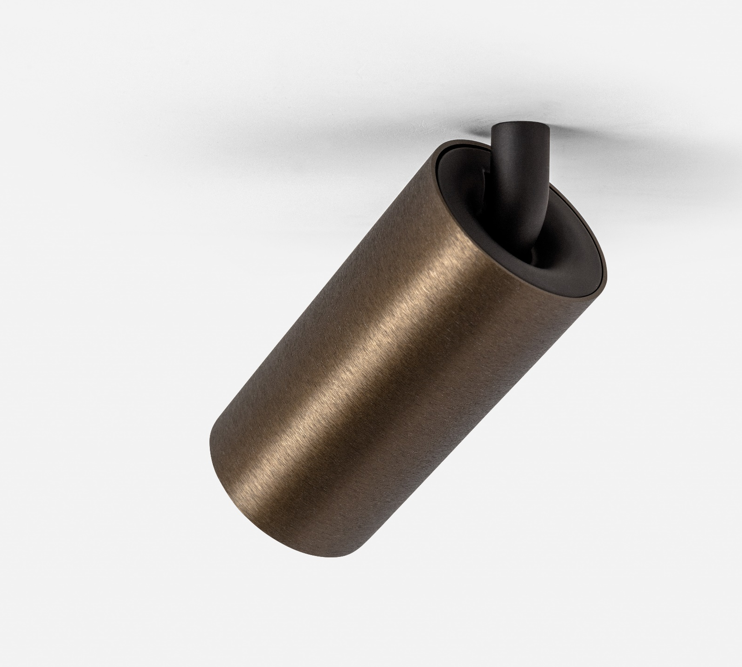
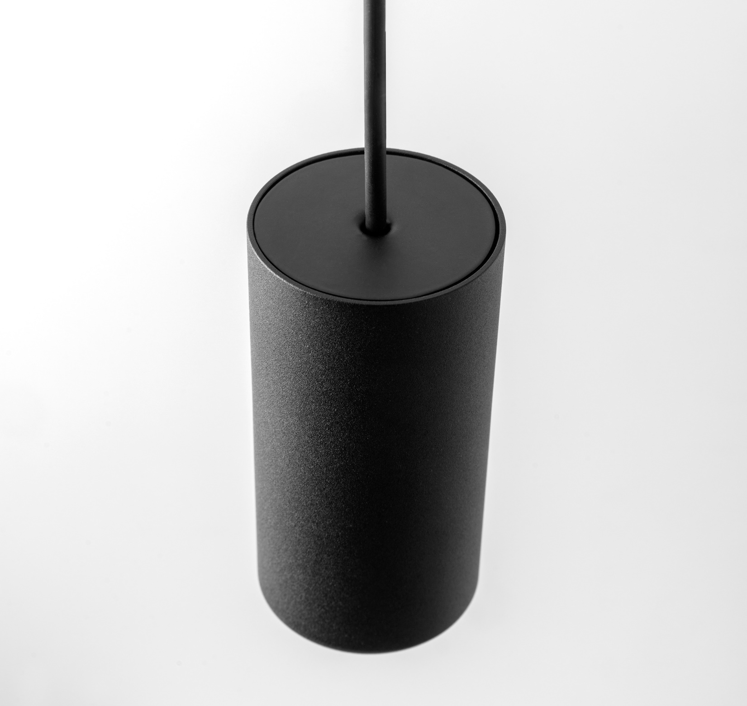
Minude
Reason of existence
A miniaturized cylinder-shaped design that expresses a very refined and minimalistic look & feel. One design language for many different applications.
What’s in a name
Minude refers to miniaturized Nude (cylinder stripped down to the essence.)
Key features
Unibody cylinder with curved inner side
Sharp, thin rim
Structured powder coated, chrome or brushed anodised sophisticated finishes
Hidden, ingenious, black matt tilting arm and back plate
Yogic flexibility (h360° v90°)
Deep recessed light source: visual comfort
Custom-made aspherical, textured lens → concentrated light beam with soft fade out adding drama and contrast in a room
Glass lens → infinite optical performance
Designed by Modular Lighting Instruments

