Slide 1
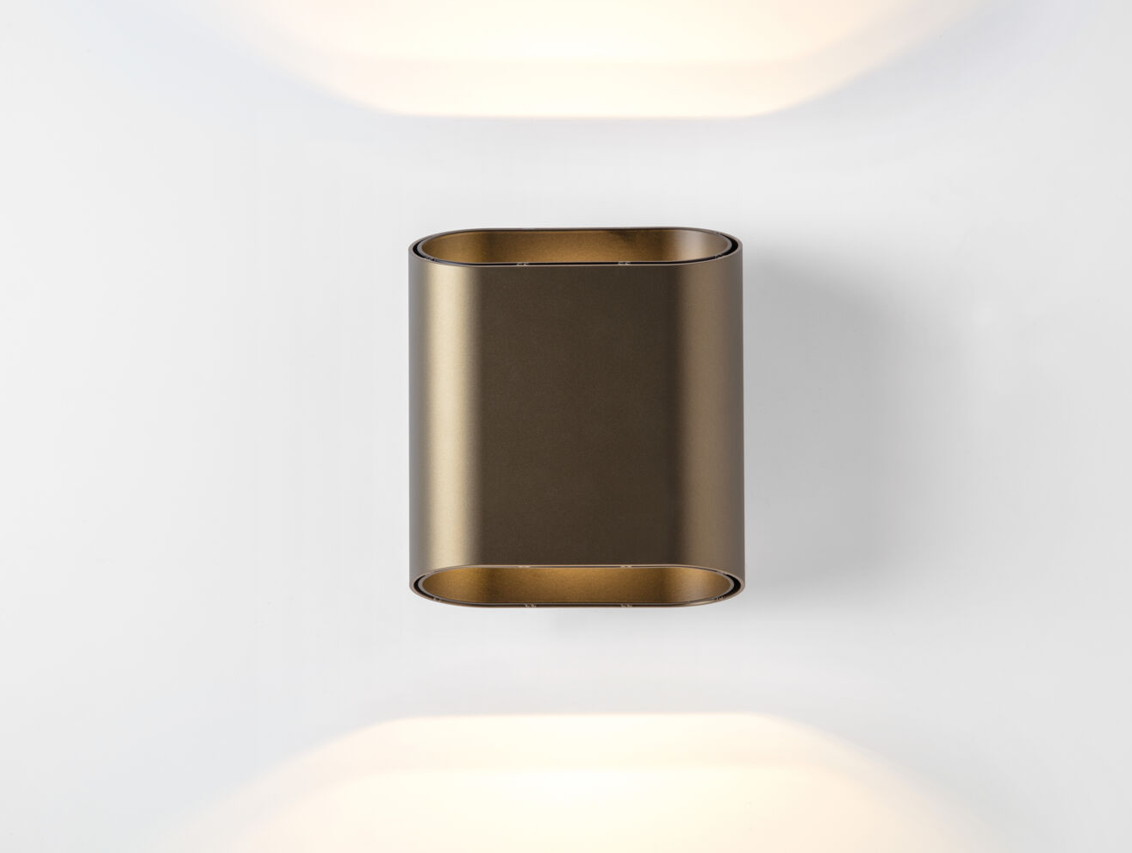
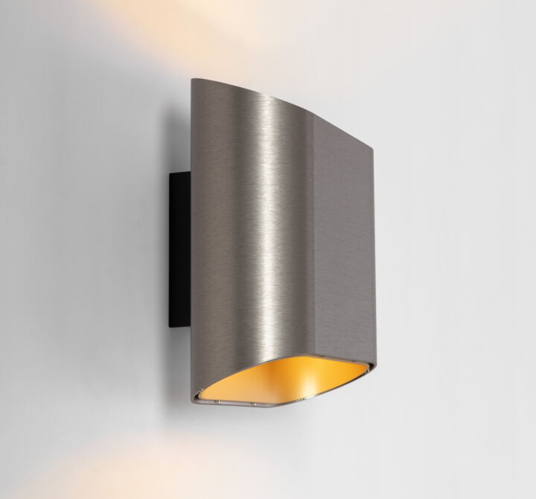
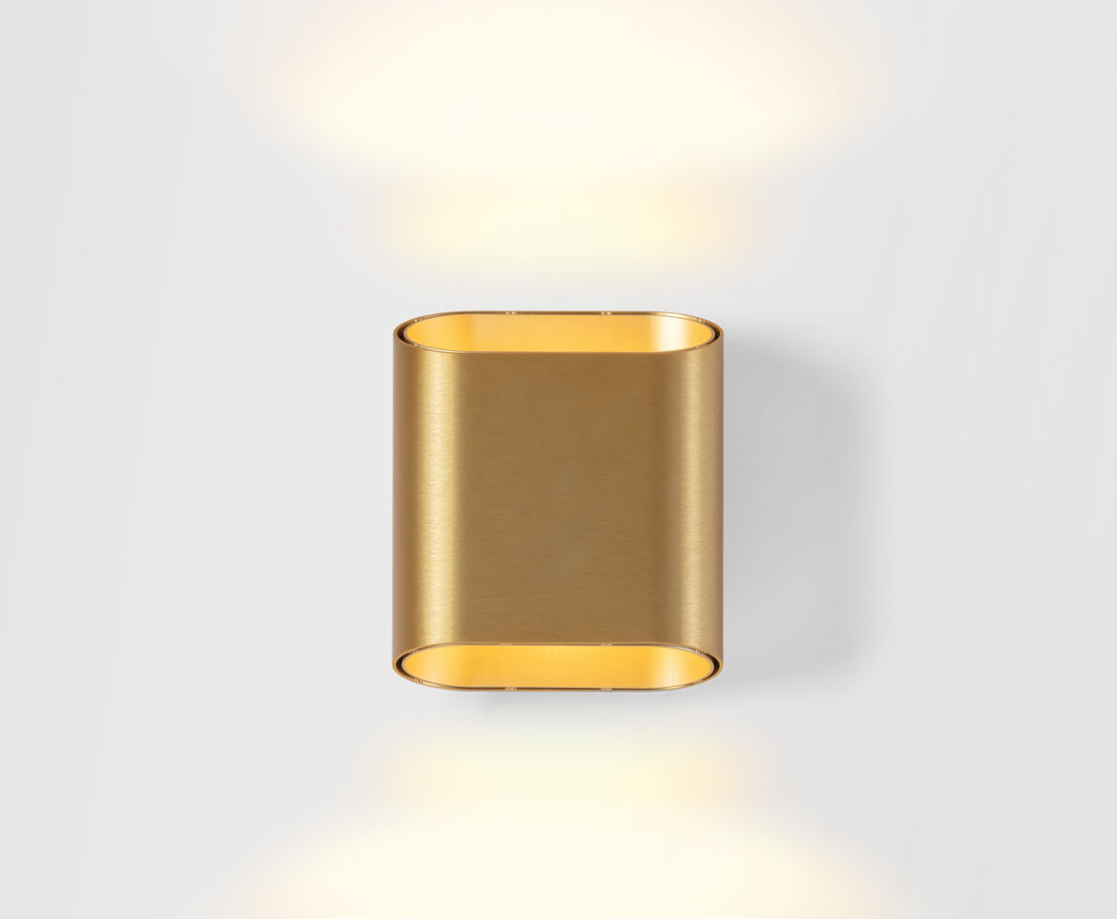
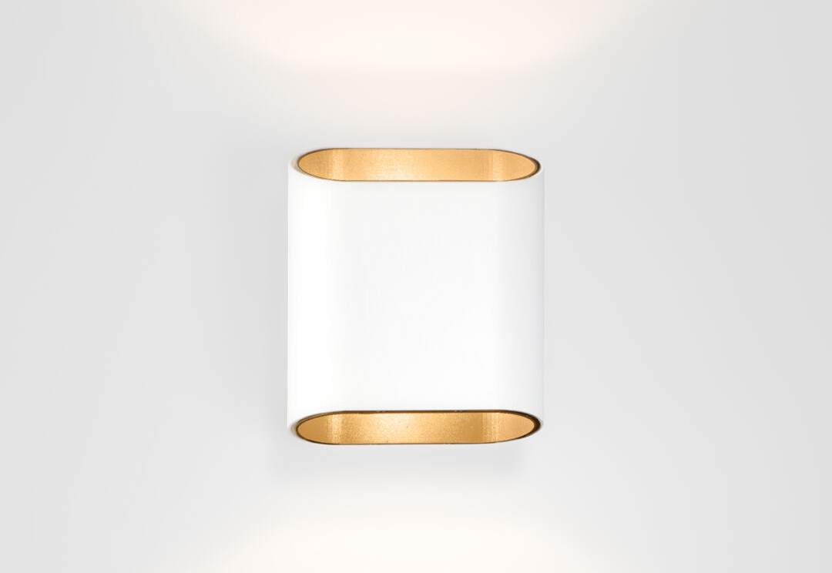
Trapz
Reason of existence
Trapz is a decorative wall luminaire that creates unique atmosphere with its indirect lighting. The flattened cylinder has two oblique openings, allowing a view into the contrasting interior of the luminaire.
What’s in a name
Trapz refers to trapezium.
Key features
Soft, organic shape
Double-walled housing in distinct finishes accentuates the duality of the luminaire
Trapz creates a wide fan of up and down light on the wall drawing interesting line patterns, contrasting the soft, organic shape
Wide range of finishes
12 different color combinations
Powder painted or brushed anodized
Designed by Modular Lighting Instruments

