Slide 1
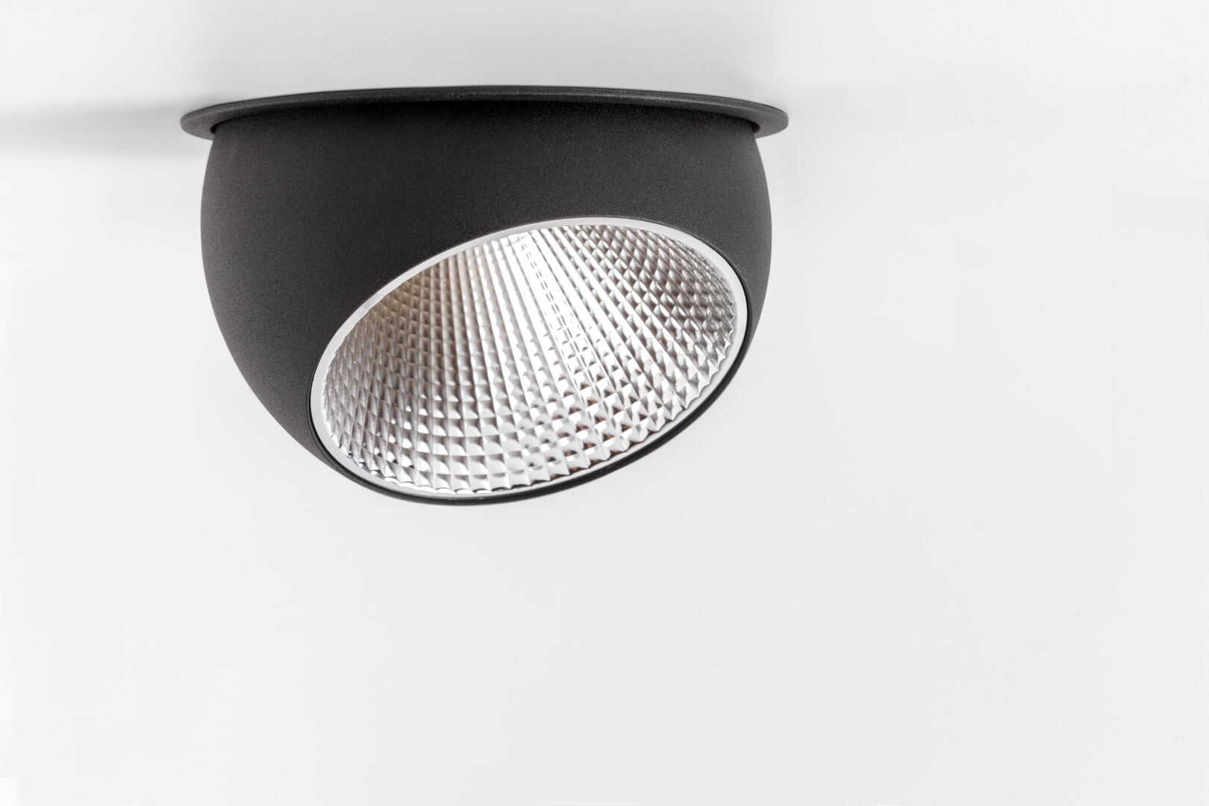
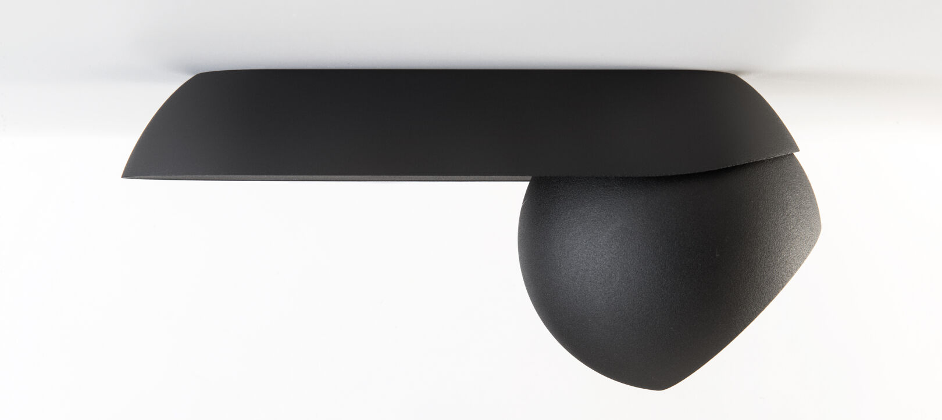
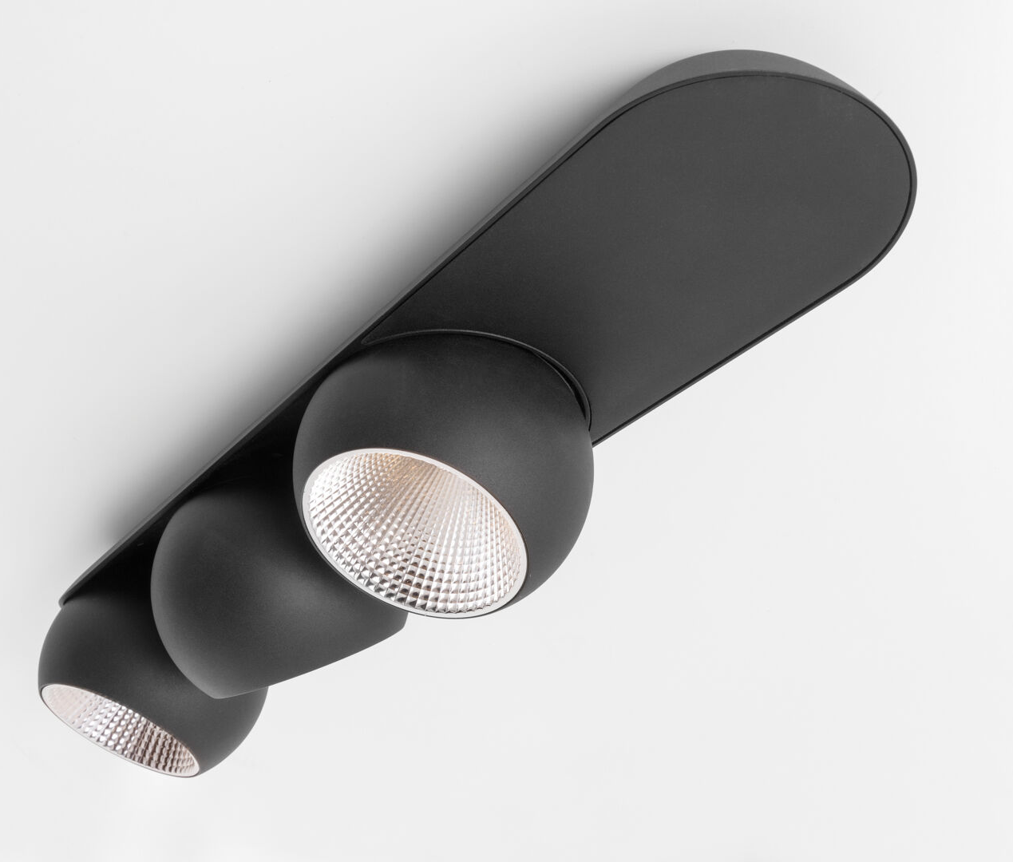
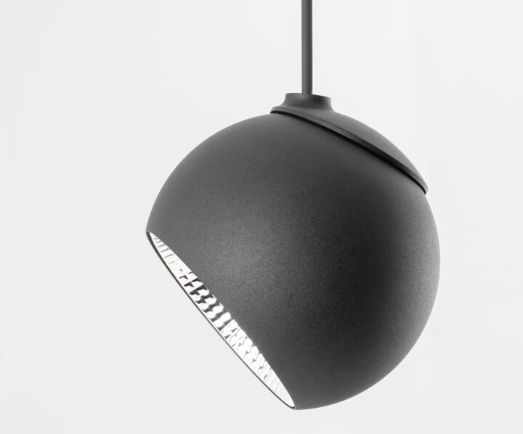
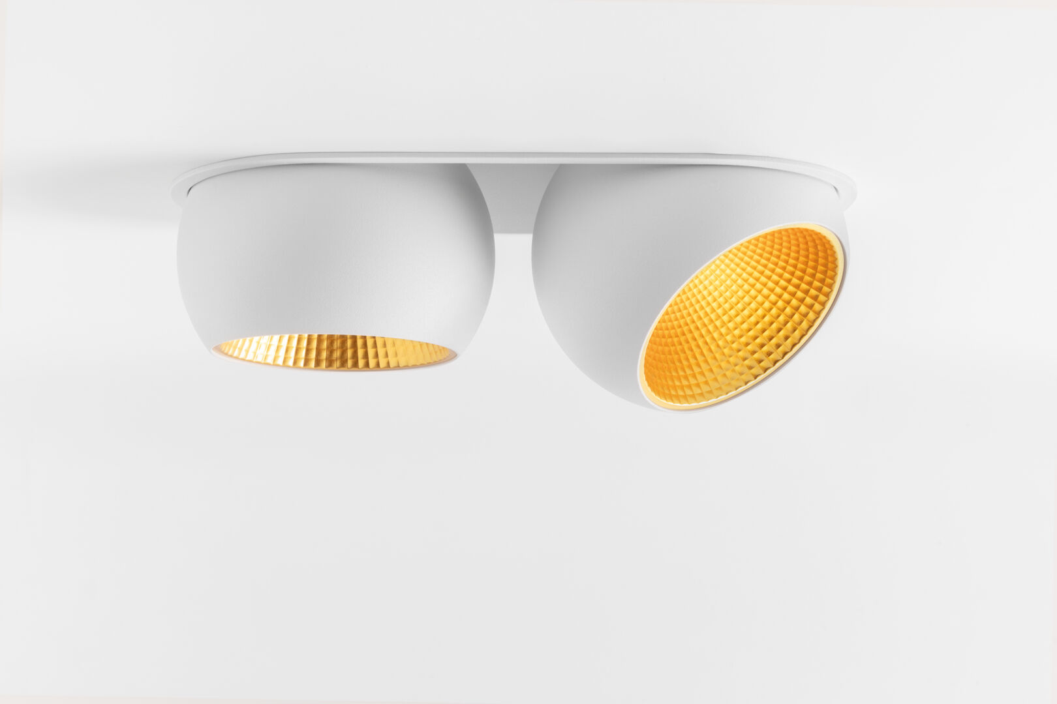
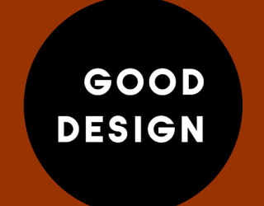
Marbul
Reason of existence
Marbul is a rounded, organic lighting family that is characterized by an extreme flexible rotation system.
What’s in a name
Marbul refers to a marble; given its spherical shape
Key features
Organic design
Streamlined driver housing for a light and elegant look
Powder coated structured finish
Unique rotation system h360° v45°
Broad application field by different variants:
Recessed:
spheres embraced by housing with ultra fine trim (5mm)
Surface:
streamlined driver housing for a light and elegant look
magnetic cover plate keeps screws and wires neatly out of sight
Suspended:
Fixed or playful adjustable spheres with thin matt black cable
Track: 230V | 48V
Kompas
Magnetic, anodised reflectors seamlessly integrated; ultra fine edge
SS | M | F
Alu | champagne | gold
Designed by Jeffrey Huyghe

