Slide 1
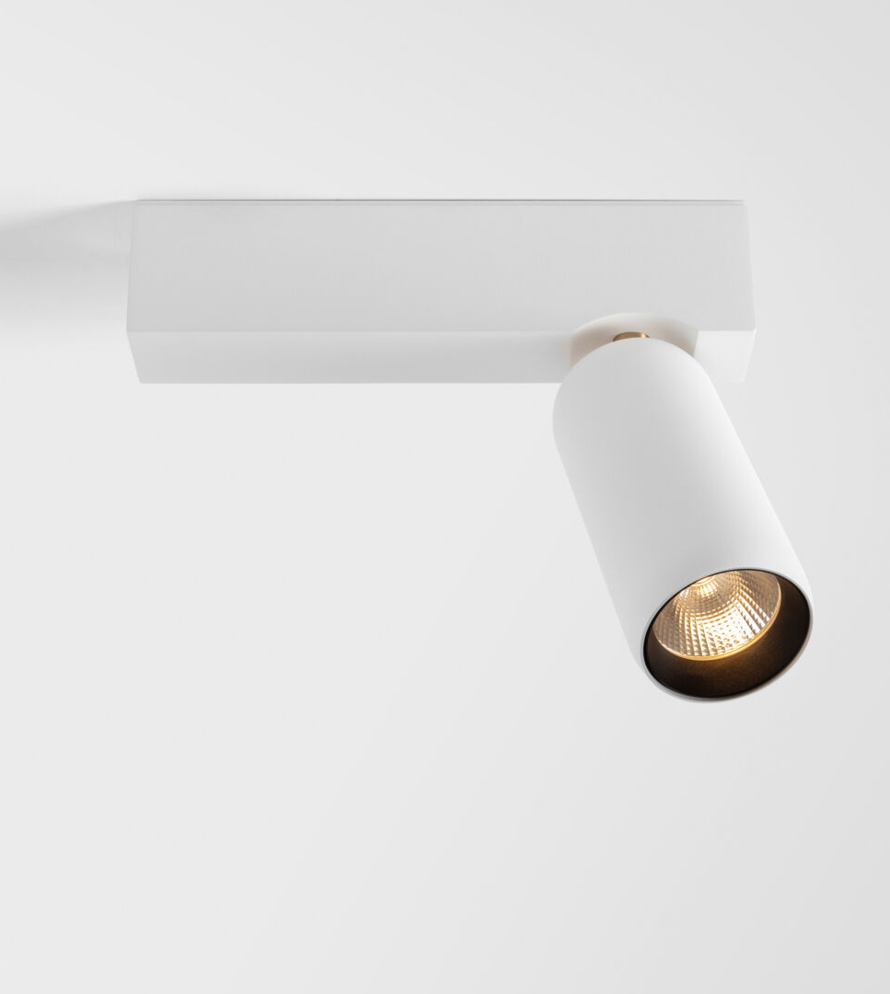
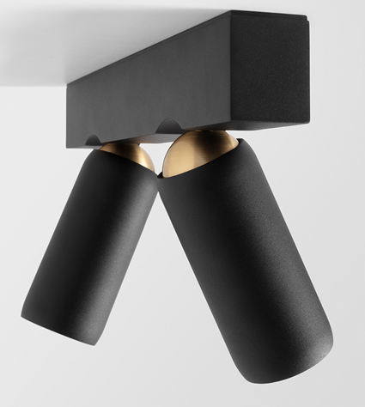
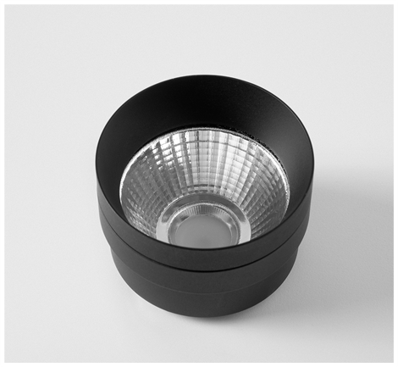
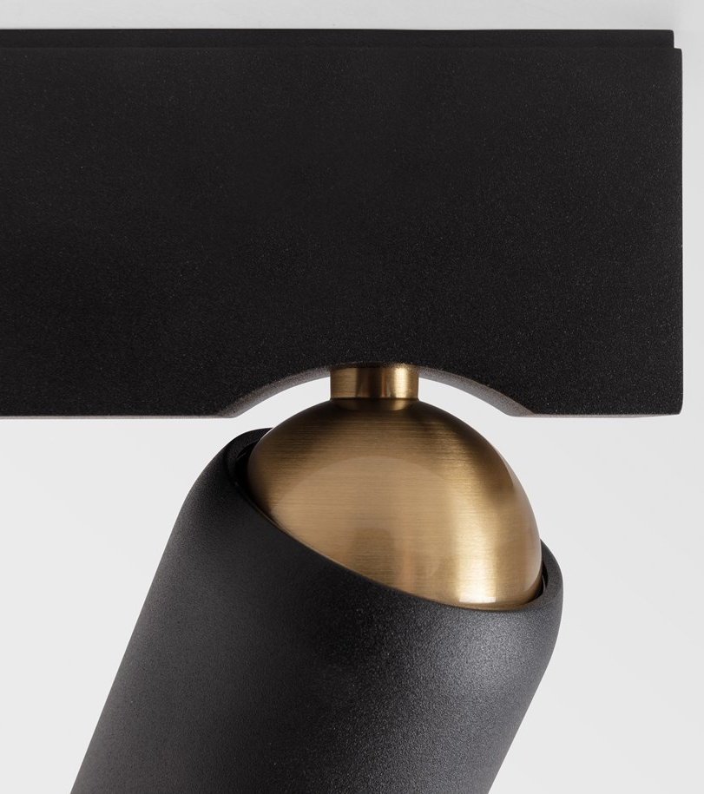
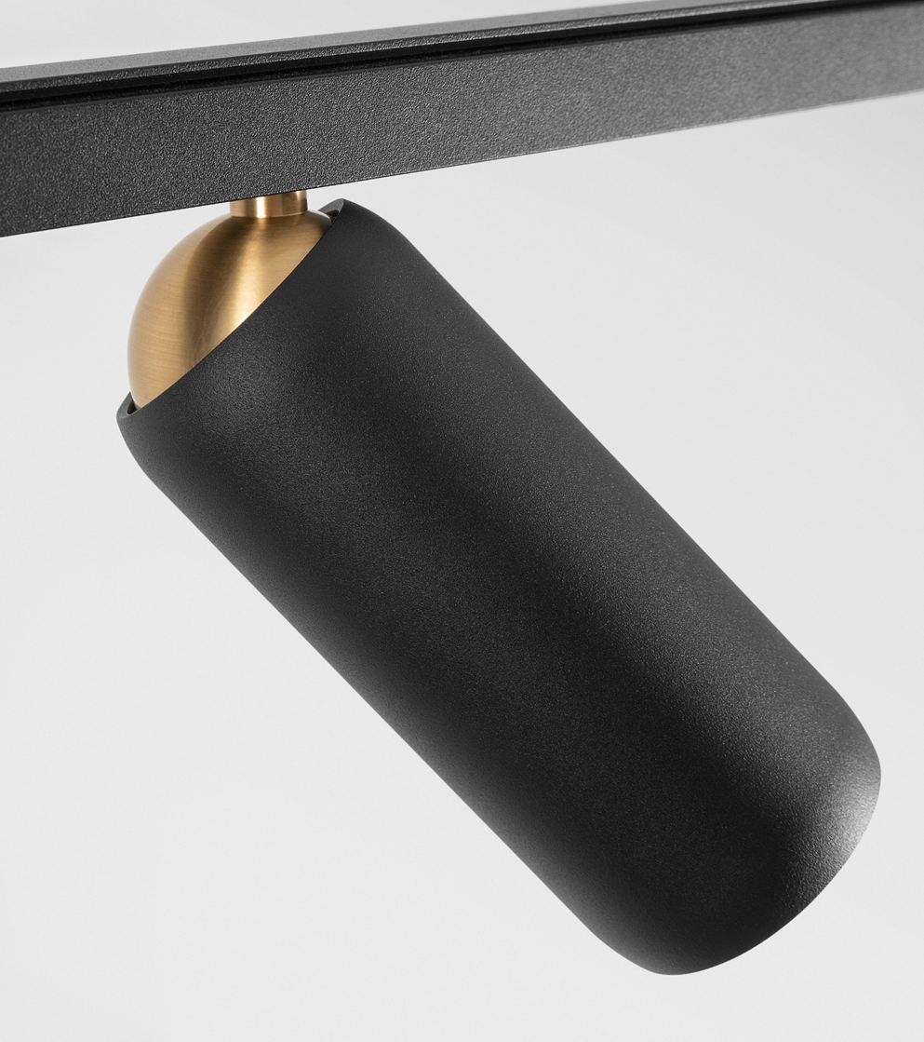
Kogel
Reason of existence
Spotlight with ingenious flexible rotation that can be applied on ceiling and wall. The design is an ode to its mechanism.
What’s in a name
Kogel refers to ball joint in Dutch.
Key features
The rotation mechanism gives its superior function and distinctive look
Clever and smooth brass ball joint
Driver housing and tube embrace ball joint
Enjoy complete freedom of rotation (h360° v50°)
Black matt front ring to enhance visual comfort
Field interchangeable magnetic aluminum reflectors (S|M|F)
Protective transparent lens covering the reflector
Versatile and powerful technology platform
Easy installation of driver housing without visible screws
Designed by Studio Kees

