Slide 1
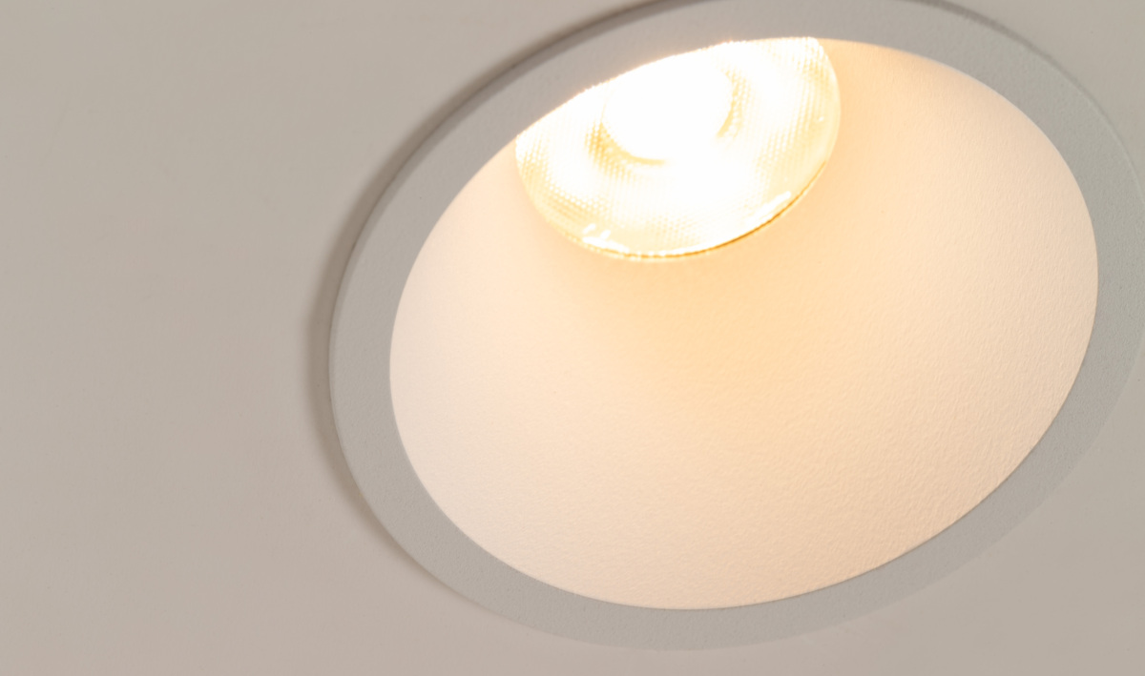
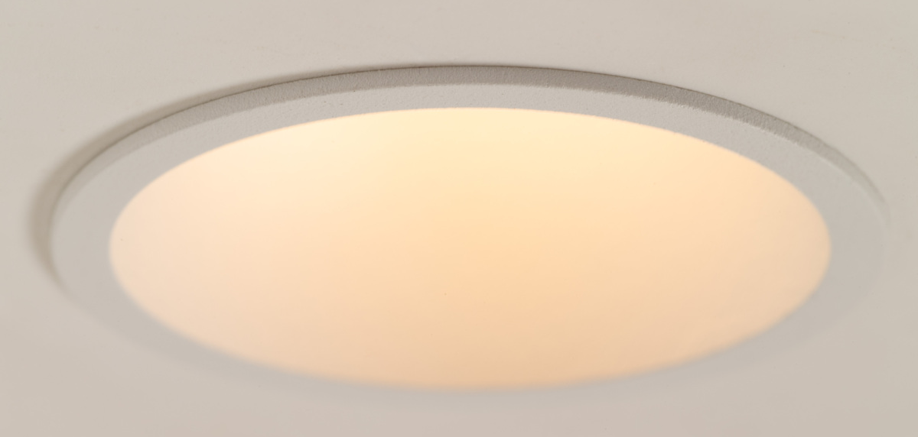
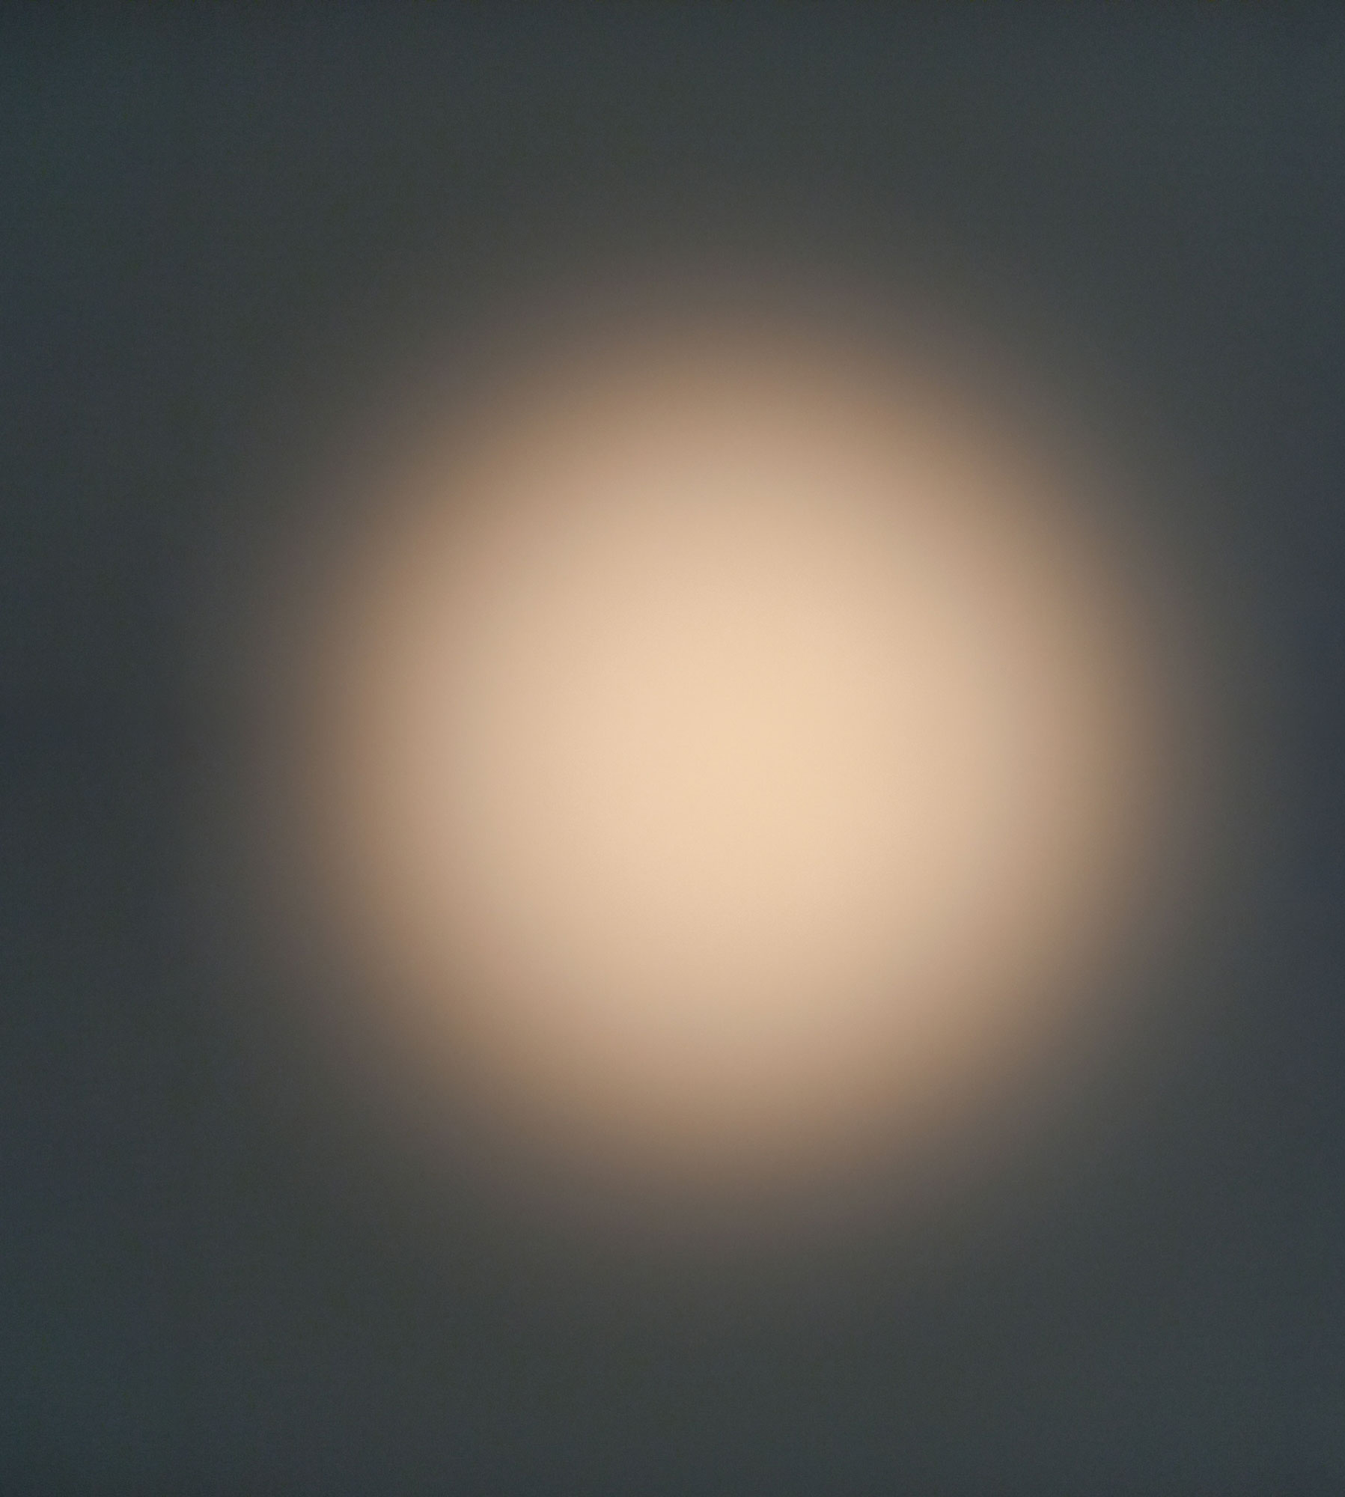
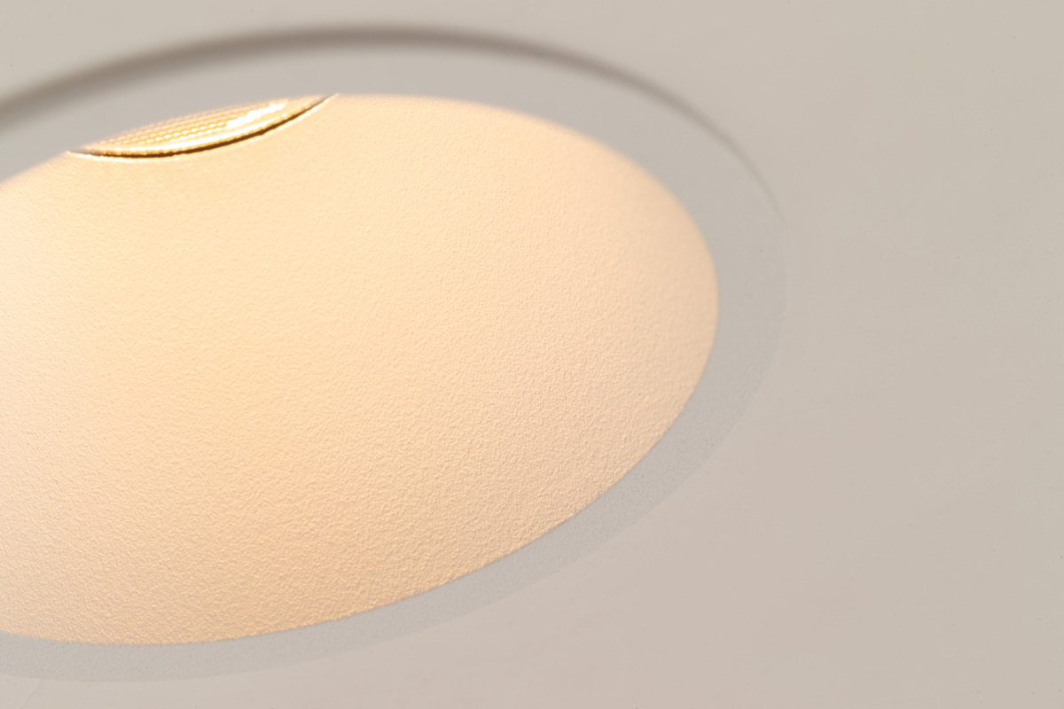
Modest
Reason of existence
Accessible recessed spot at competitive price level
What’s in a name
A new product family with limited, straightforward offering
Key features
Aluminum, powder coated body with a 4mm trim
Deep recessed spot for enhanced visual comfort
Highly efficient polycarbonate TIR lens creates uniform light beam
IP55 rating
1 design, 1 CCT, 1 beam angle, no choice stress ;-)
A breeze to install thanks to the leaf springs
Designed by Modular Lighting Instruments

