Slide 1
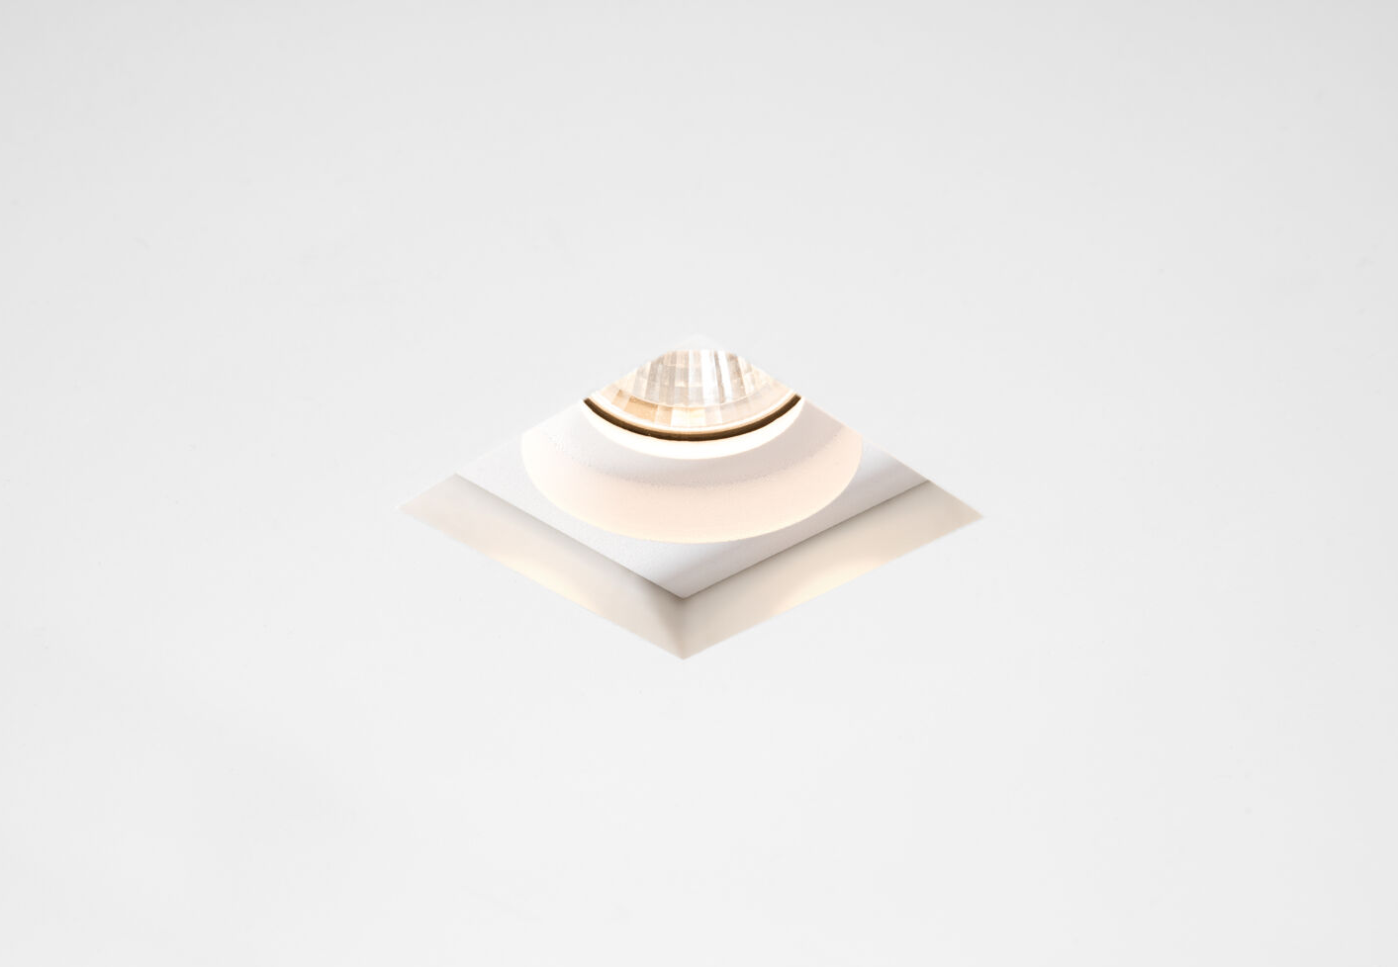
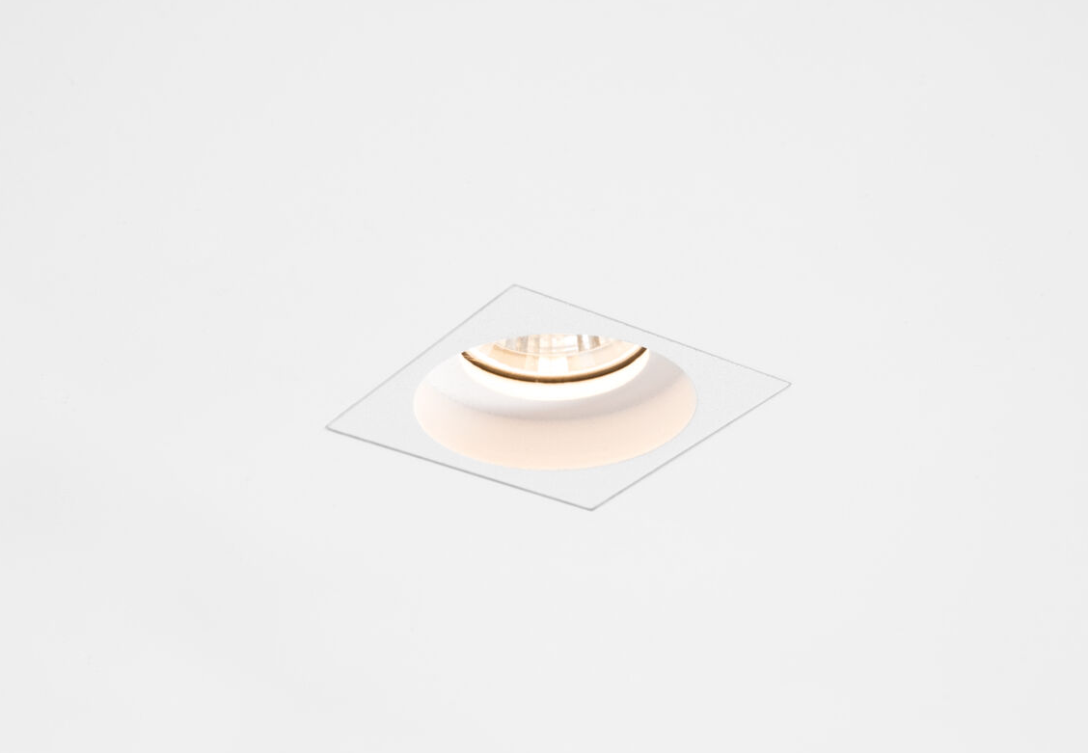
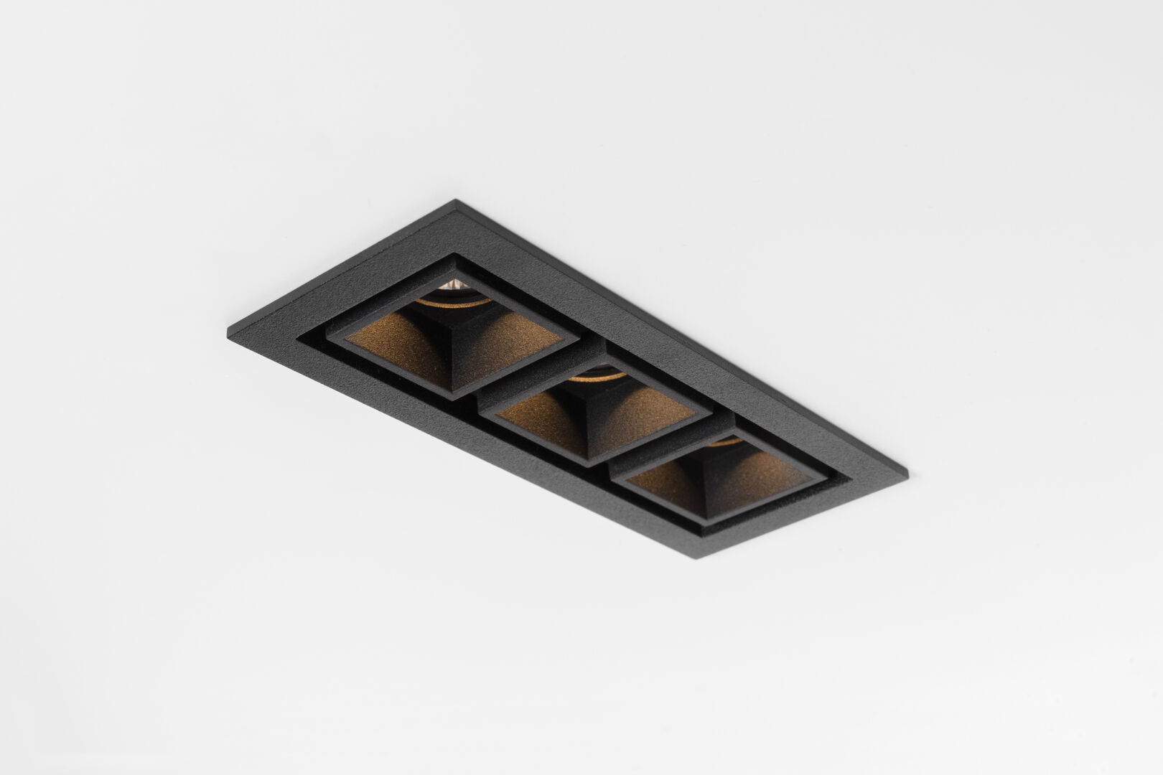
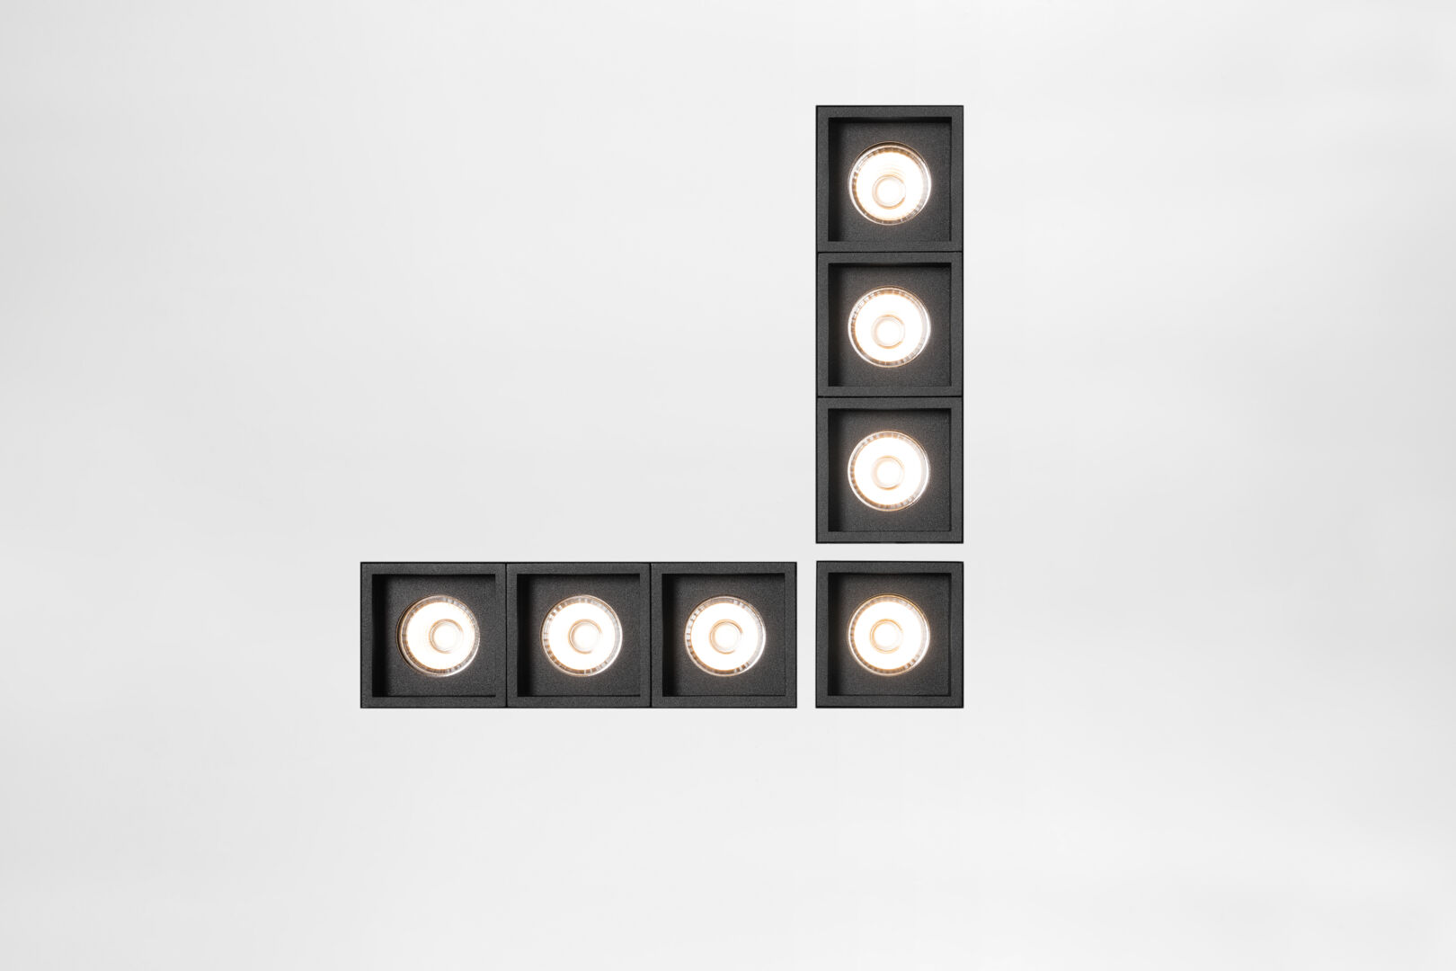
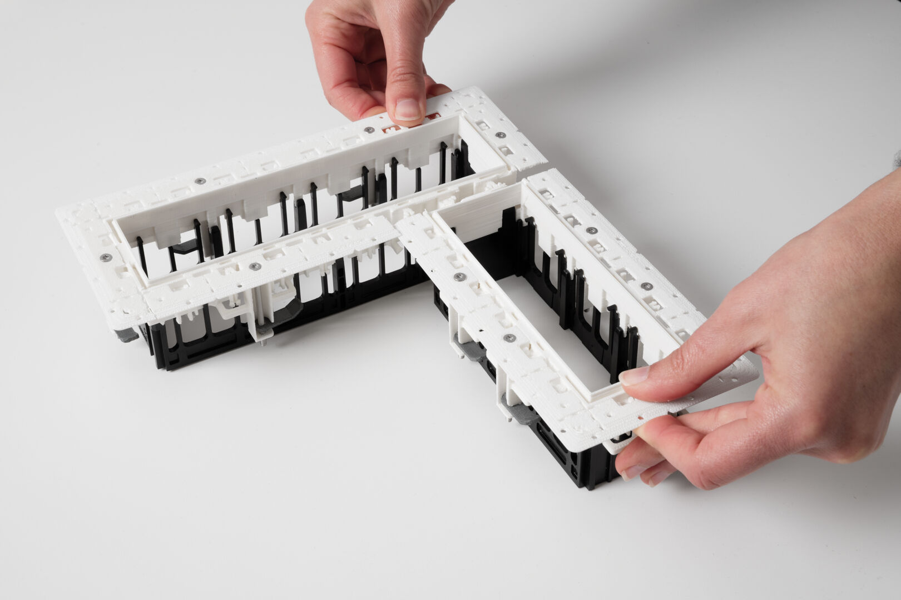
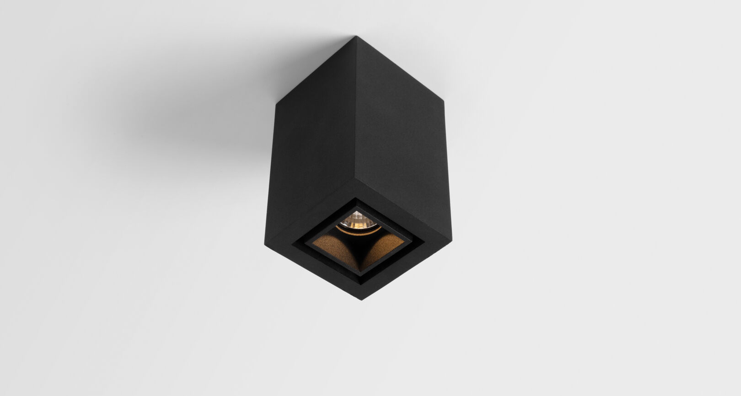
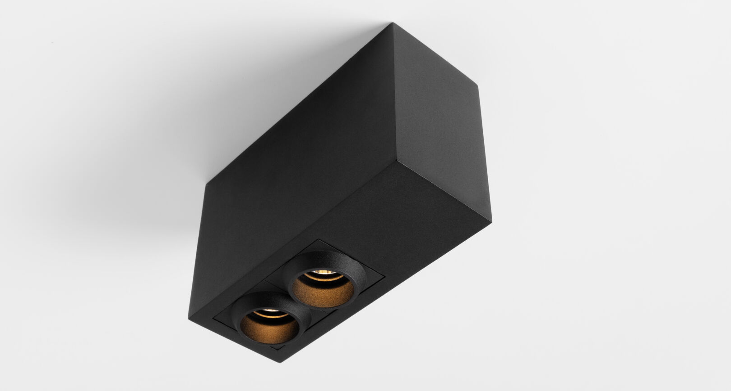
Qbini
Reason of existence
A range of miniaturized, square building blocks that allows you to compose your own creative light patterns. Qbini literally removes the borders to your creativity.
What’s in a name
Qbini is a contraction of cube & mini.
Key features
Broad platform of different building blocks:
lamp units
accent lighting | general lighting
fix or adjustable
symmetric or asymmetric
9 designs
IP55 (except adj. unit)
frames
trimmed or trimless (clickable to achieve a perfect 90° or 180° alignment)
for 1 up to 4 Qbini’s
surface boxes
For 1 up to 2 Qbini’s
DE | DI
accessories
3 anti glare accessories
blind cover (including sensor integration)
Patented press-in, press-out technology makes it a breeze to install, change and service.
Dual positioning of light sources: (deep) recessed
Designed by Florent Coirier

