Slide 1
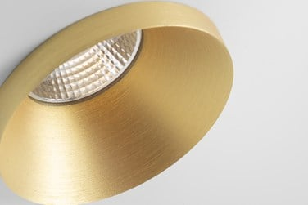
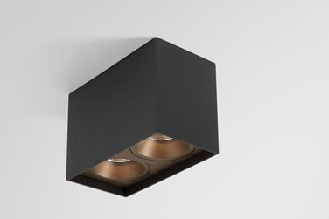
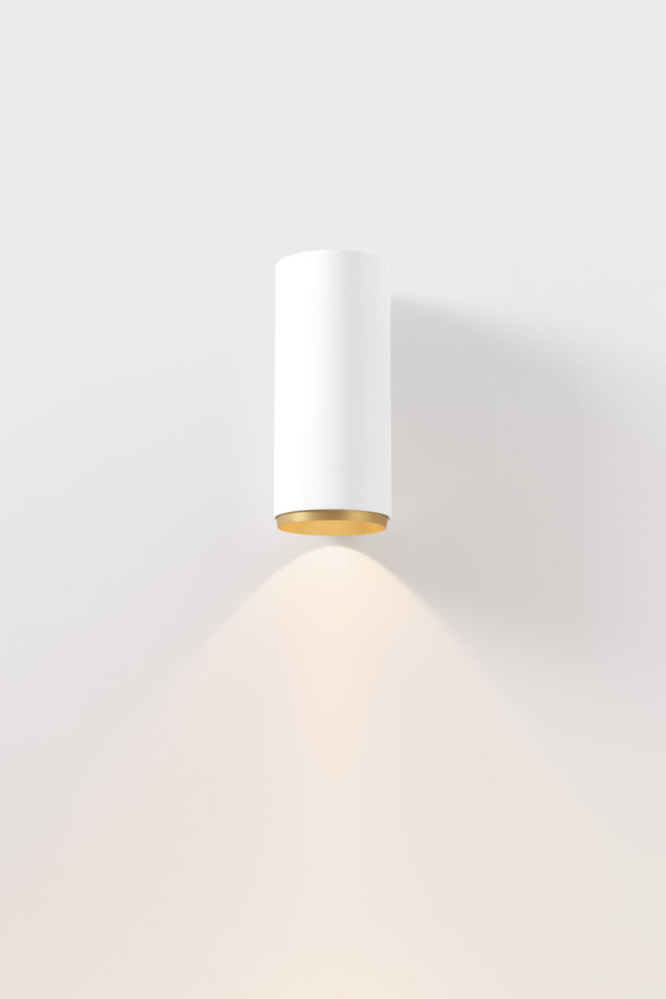
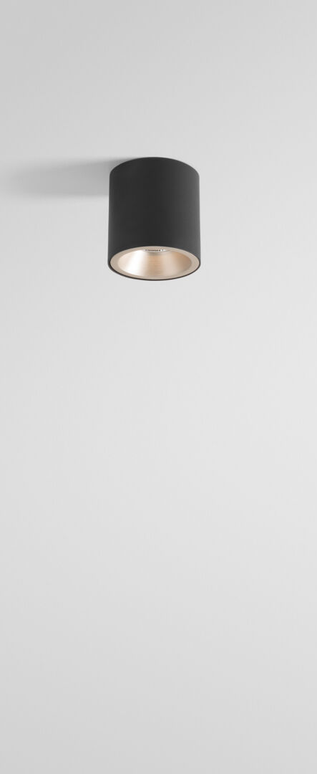
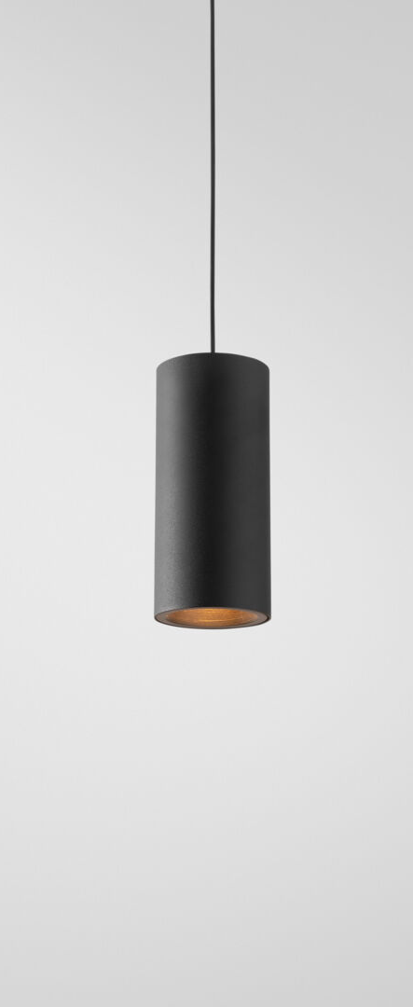
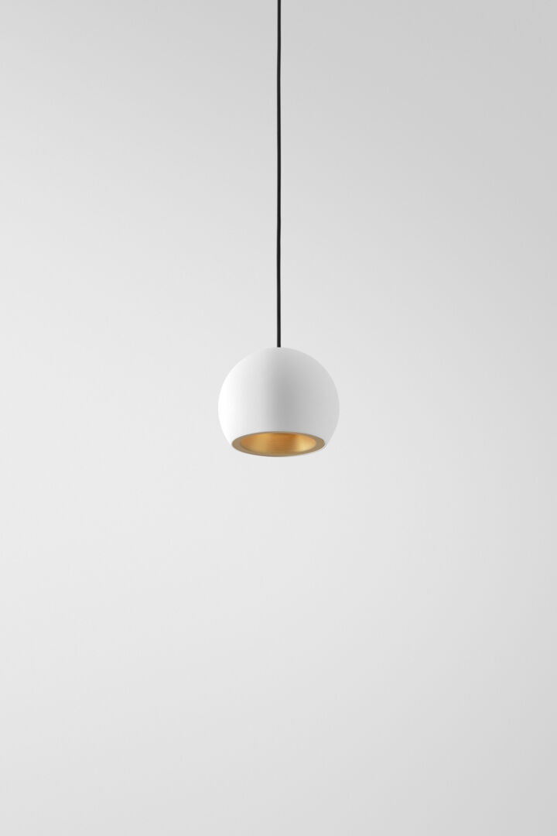
Smart
Reason of existence
The most versatile, modular downlighter.
Broad platform that consists of different designs, shapes, sizes, colors and mounting options. Create a playful installation while maintaining a consistent look and feel.
What’s in a name
Smart refers to the smart choice for any application.
Key features
3 different designs in 4 different sizes
Deep recessed light source
Fixed or adjustable
IP20 or IP55
Mix and match:
Mask: covers large holes or creates a nice square/rectangular accent
Box: surface-mounted DE or DI
Tube: surface-mounted or suspended DE or DI
Ball: suspended DE or DI
From orientation to accent and general lighting
from 100 up to 4500lm
3 CCT’s
Warm dim technology
S| M | F | WF
Gu10 version allows easy smart lighting solution
Structured powder coated or wet painted (brushed) finishes
Designed by Modular Lighting Instruments

