Slide 1
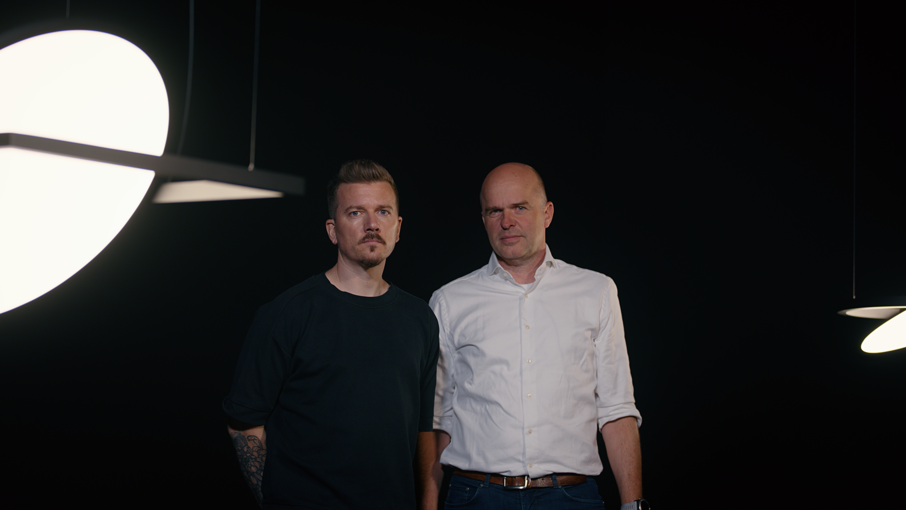
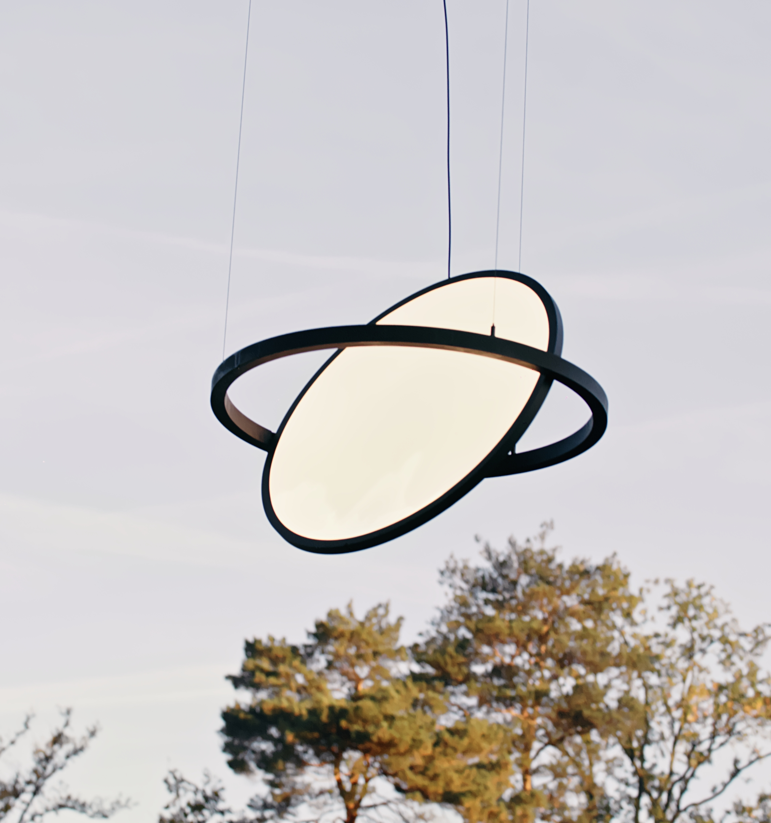
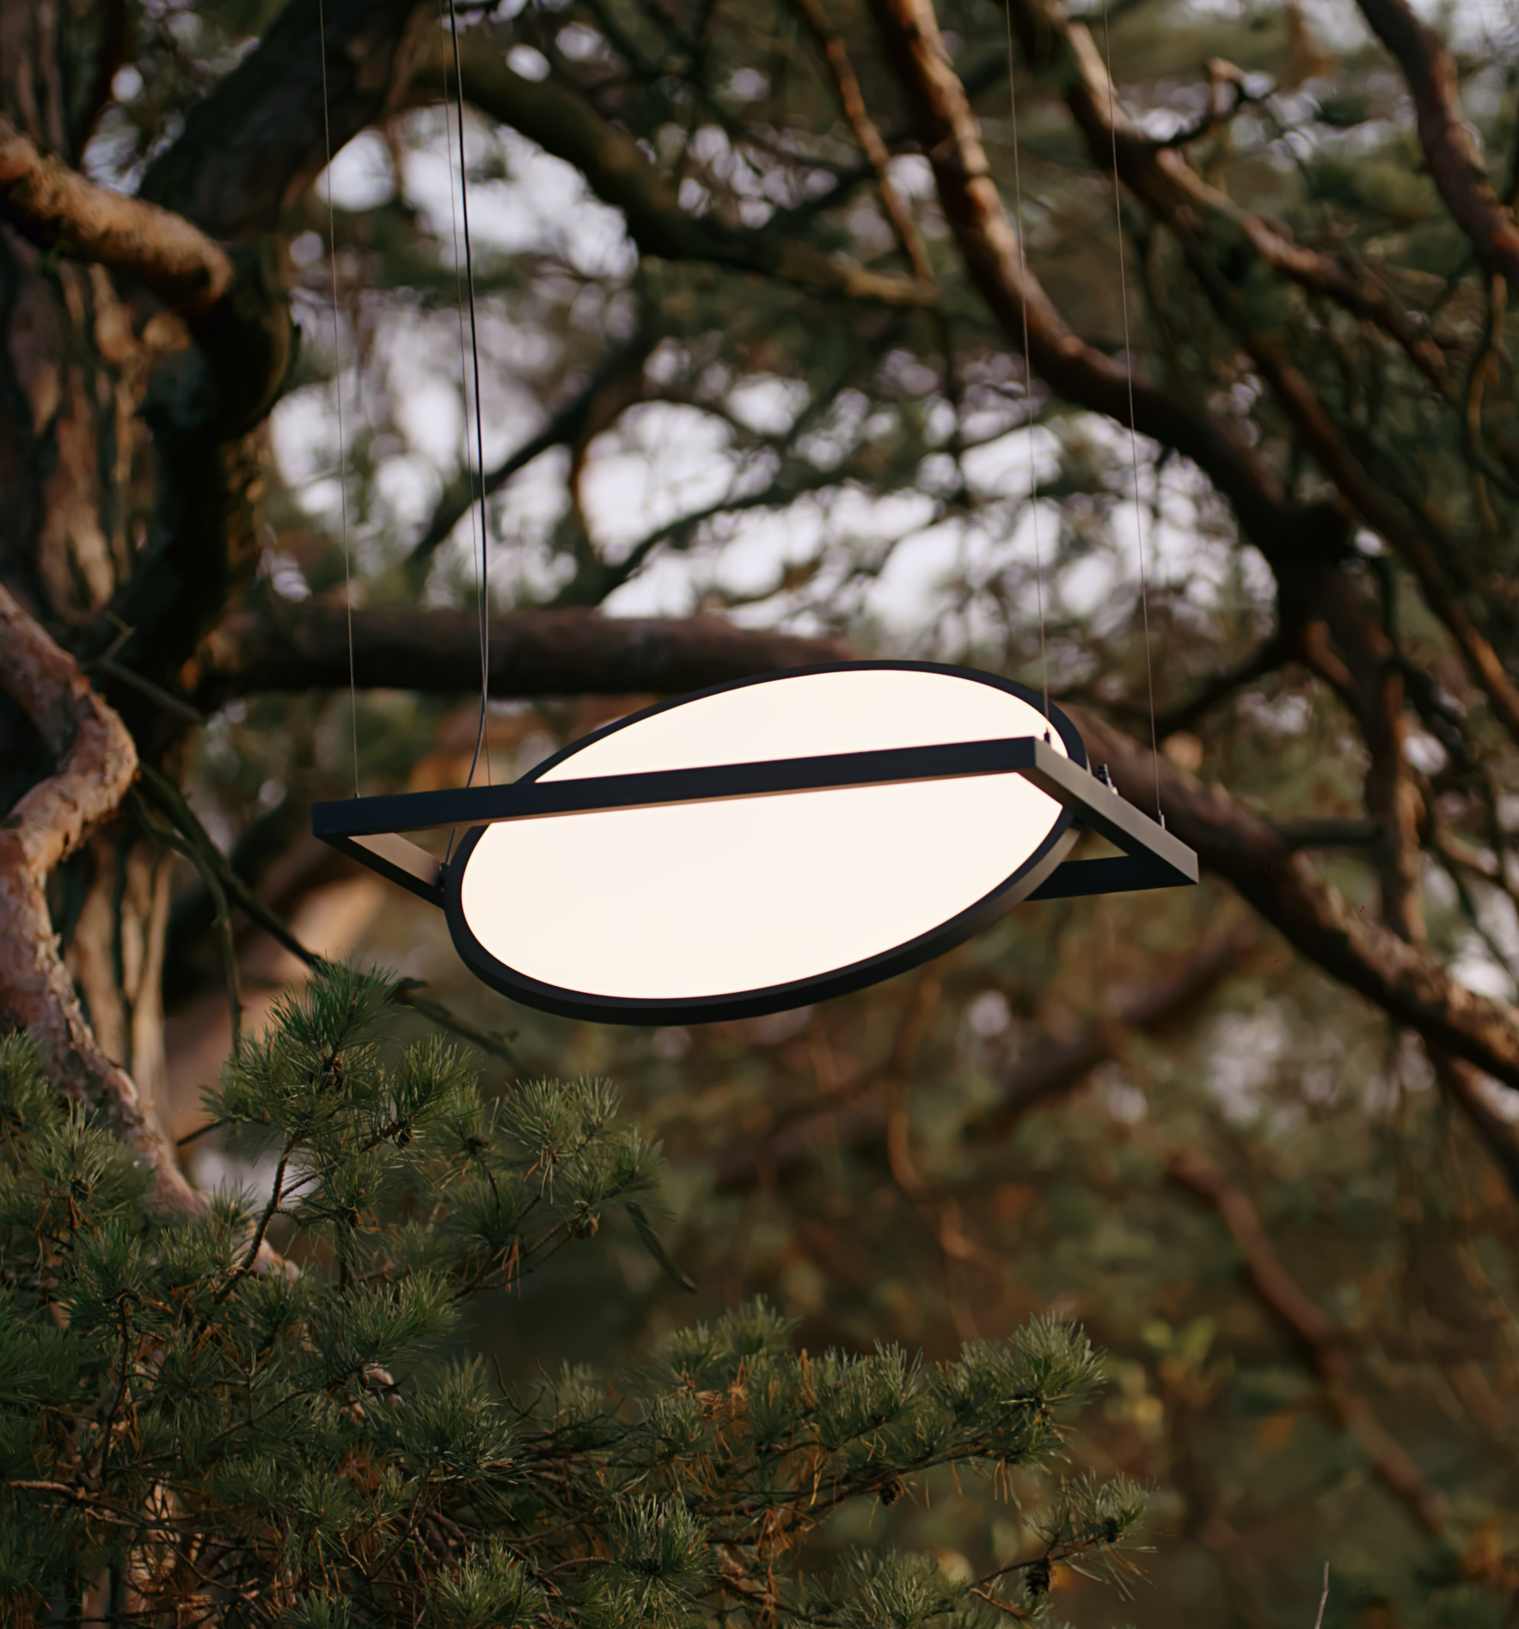
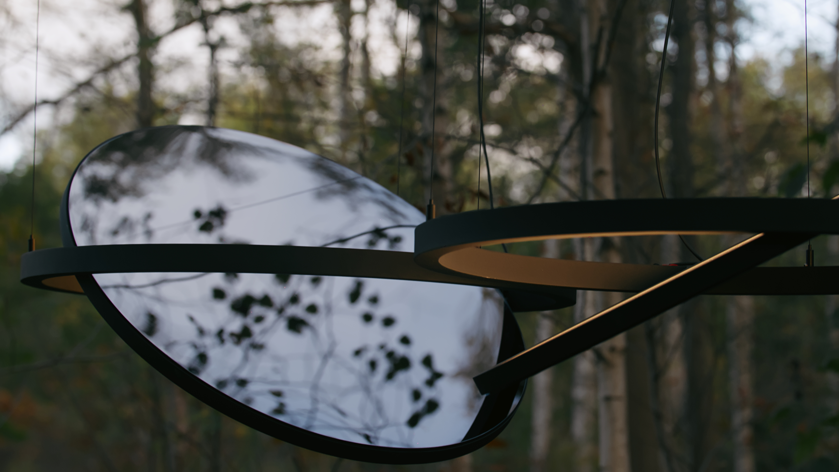
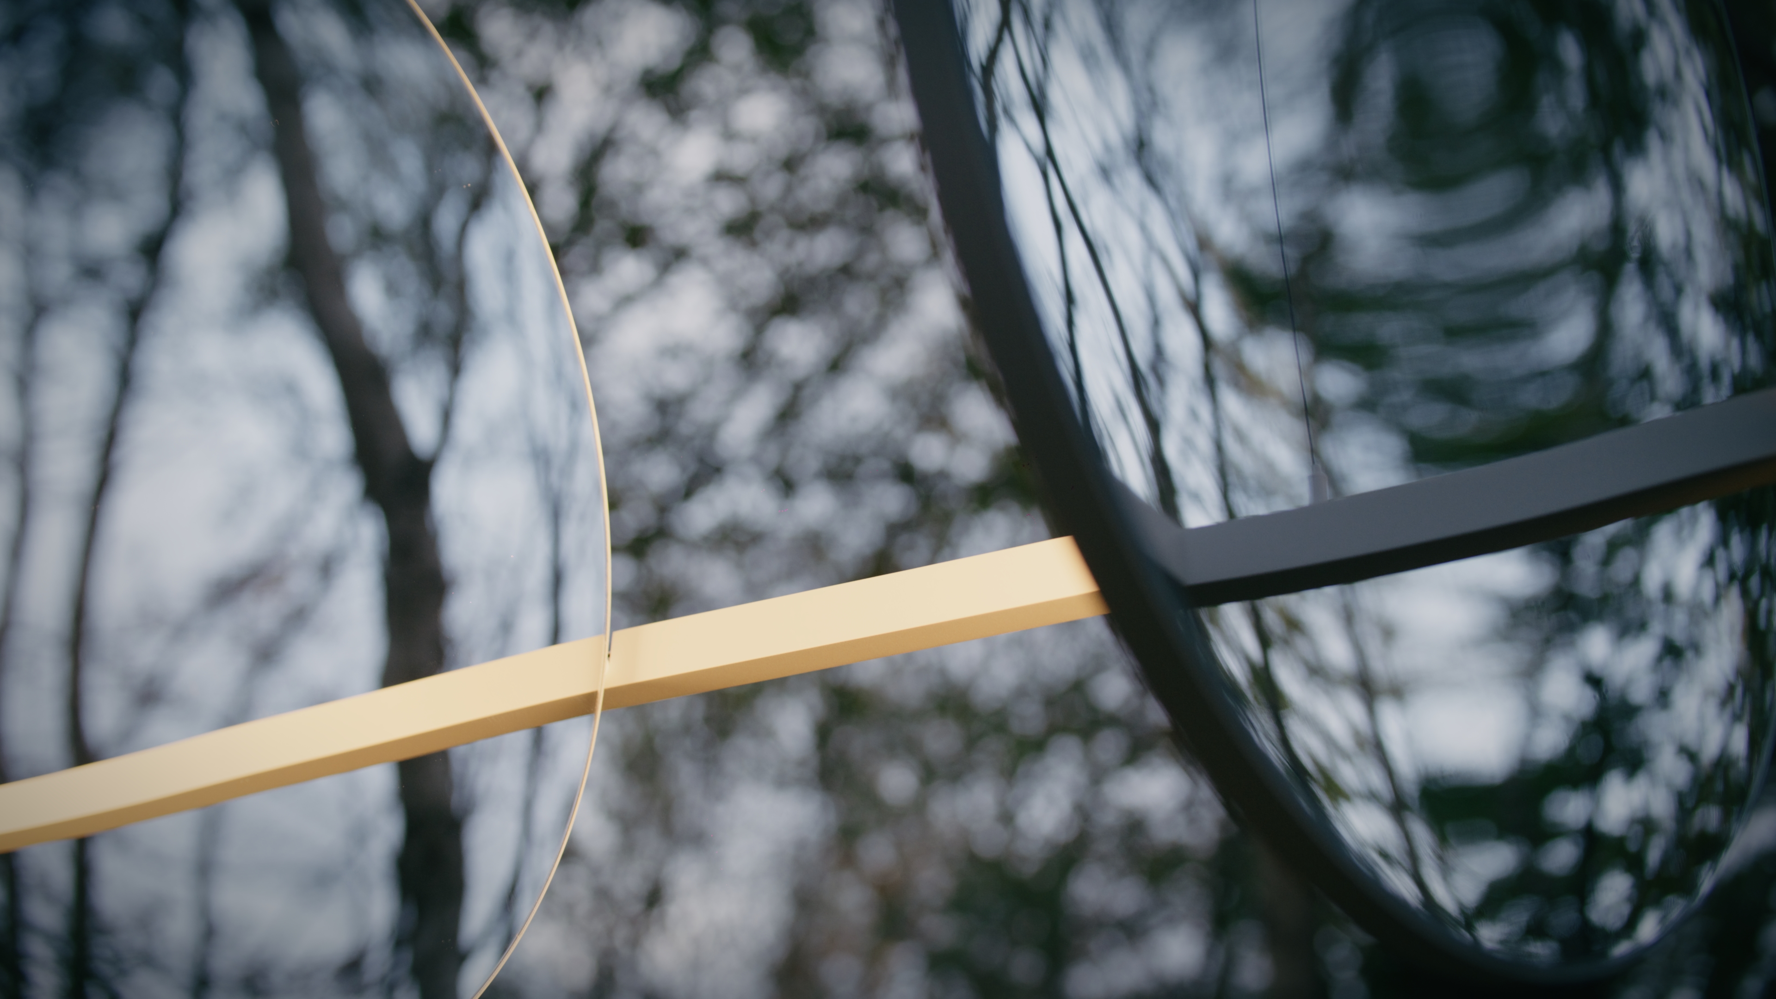
Geometry
Reason of existence
Geometry is a voluminous suspended luminaire that brings uniform lighting to a space. It has the ability to change the atmosphere by its direct or indirect light effect.
It harmonizes splendidly in large, grand areas.
What’s in a name
The design is a composition of basic geometric shapes: square, rectangular and circle.
Key features
Thin and slim design
360° rotation of LED panel
  Adaptive to the users ever changing needs and activities
  Position the panel up or down or every angle in between
Variant with mirrored backplate in silver or black chrome:
  Creates optical illusion; blends with the space
  Connects to black chrome products
Matt, uniform light effect thanks to sidewards positioned LED strip in combination with multi layered optical system
Optional mechanical clips to connect frames at a fixed distance (5mm)
Eye for detail: no visible screws, cover plates for hinges and suspension cables
Quality over lifetime: no UV discoloration, L80B20, serviceable, endless rotations
Designed by Florent Coirier (FR) & Stig Myler (DK)

