Slide 1
Bold

Slide 2
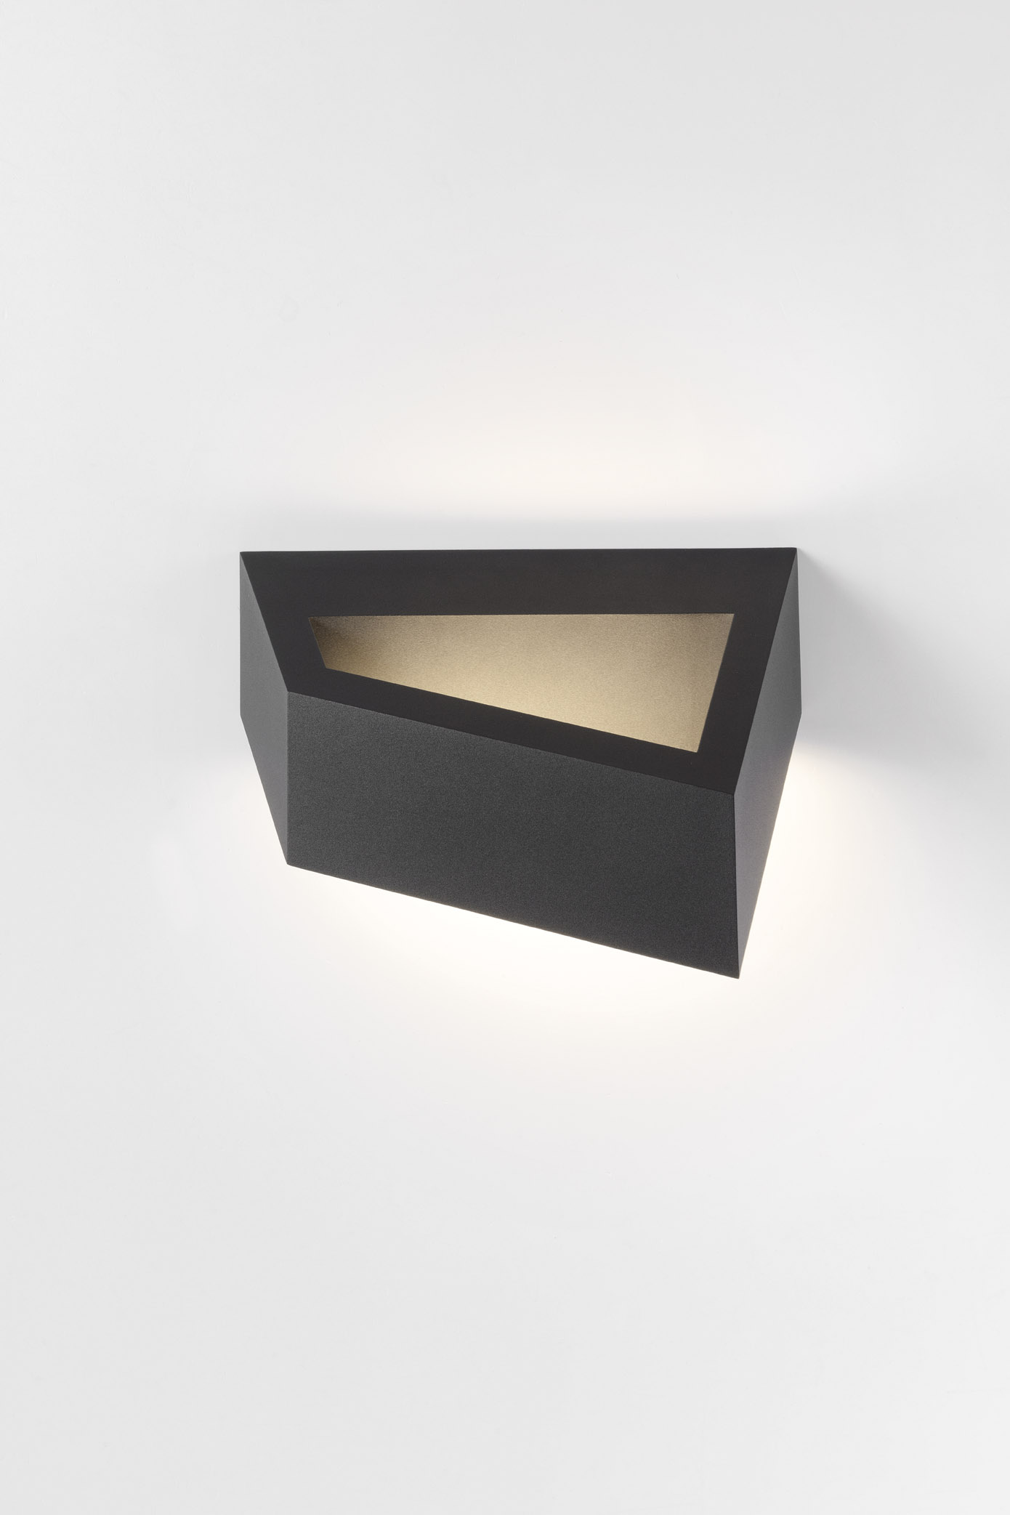
Bold
A paradox in luminaires

Slide 3
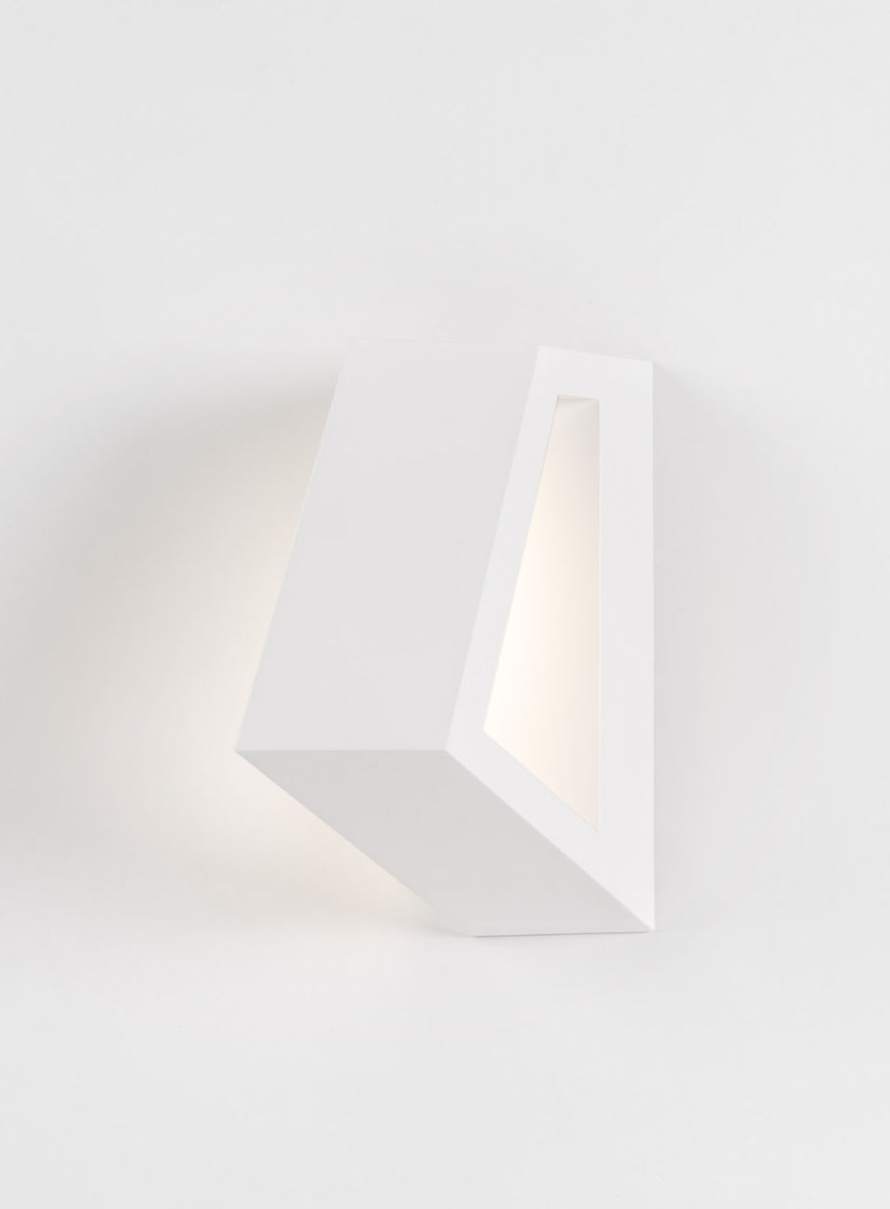
About Bold
Strong architectural shape
Statement by shape
Indirect up/down light effect
Design in cooperation with Studio Kees

Slide 4
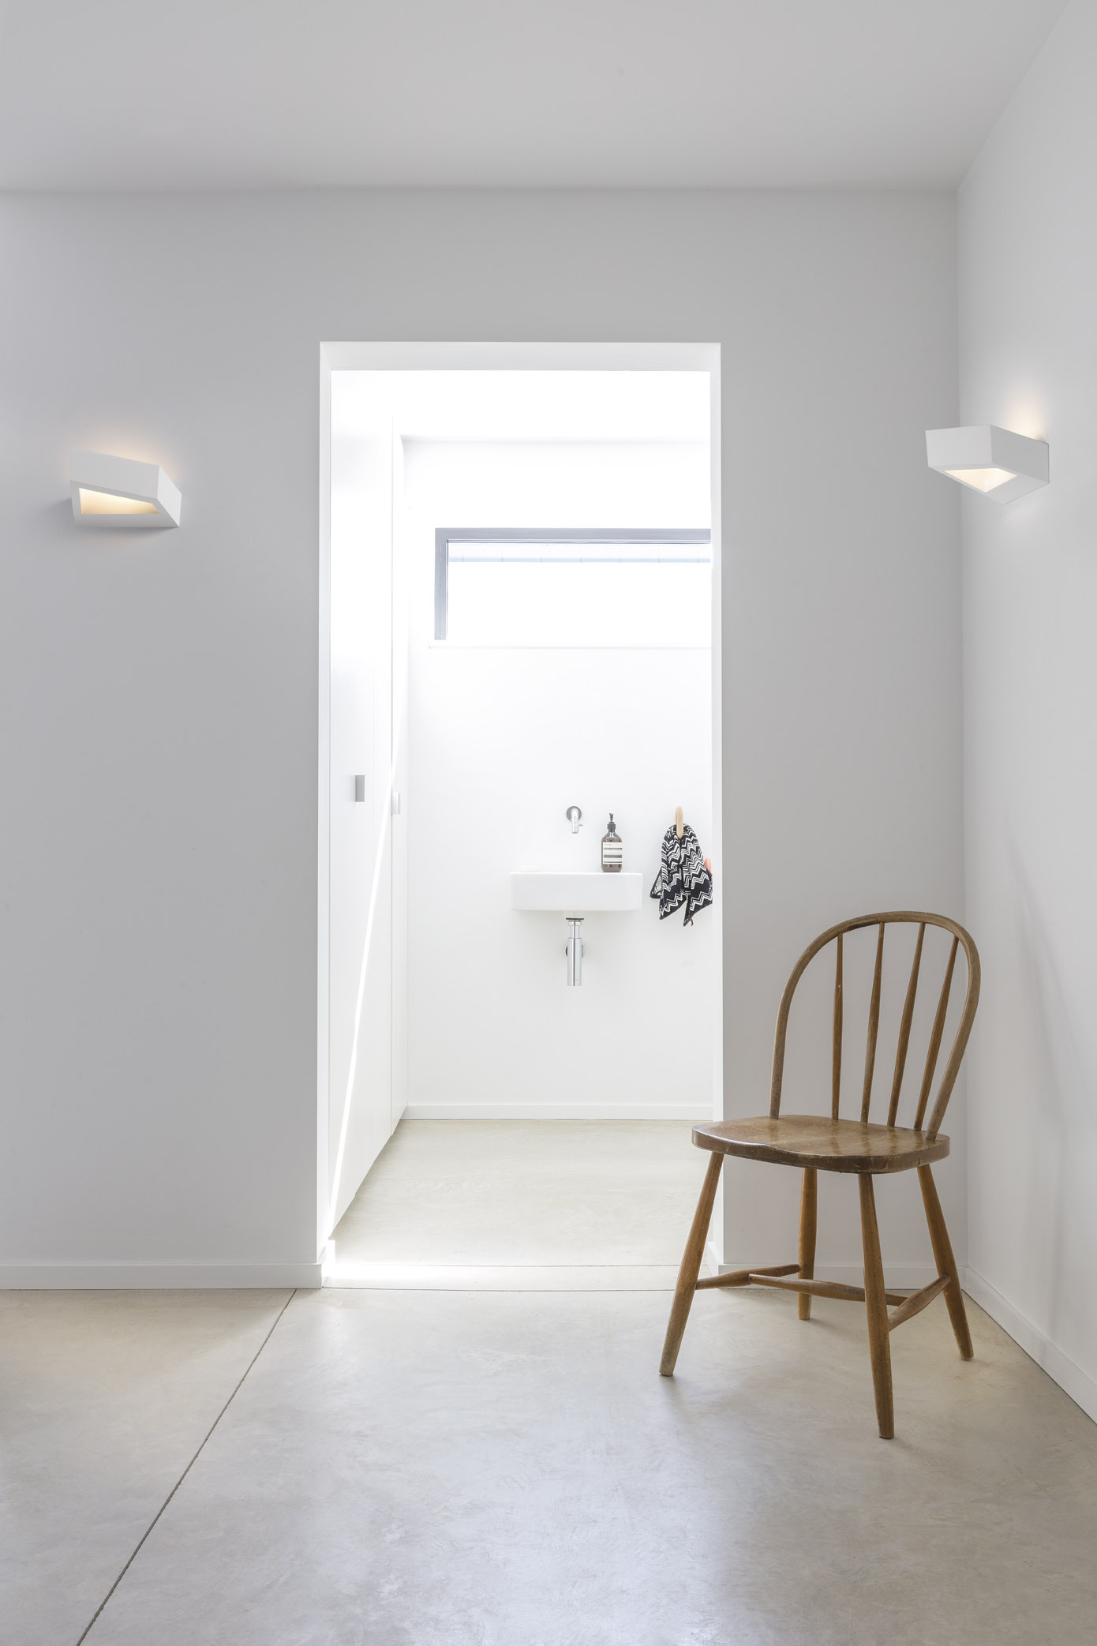
Market segments
High-end residential
Hospitality

Slide 5
Design

Slide 6
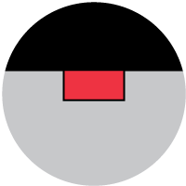
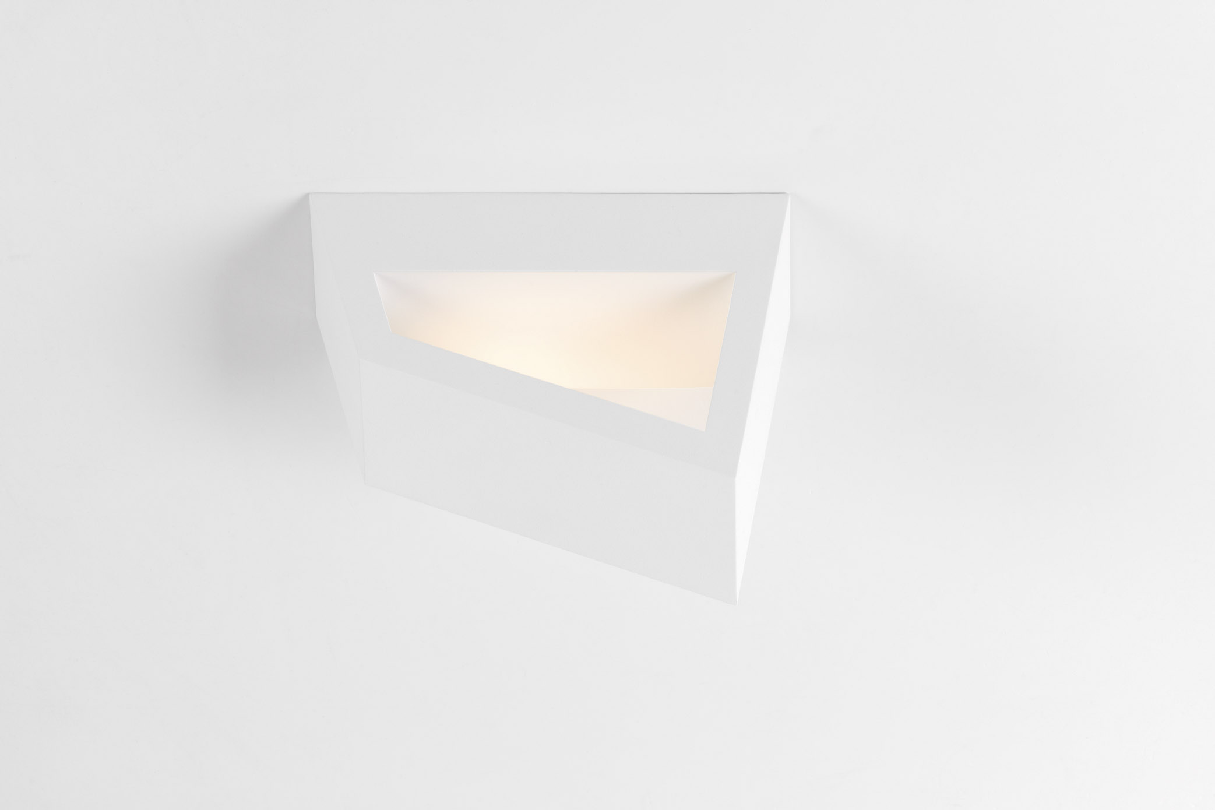
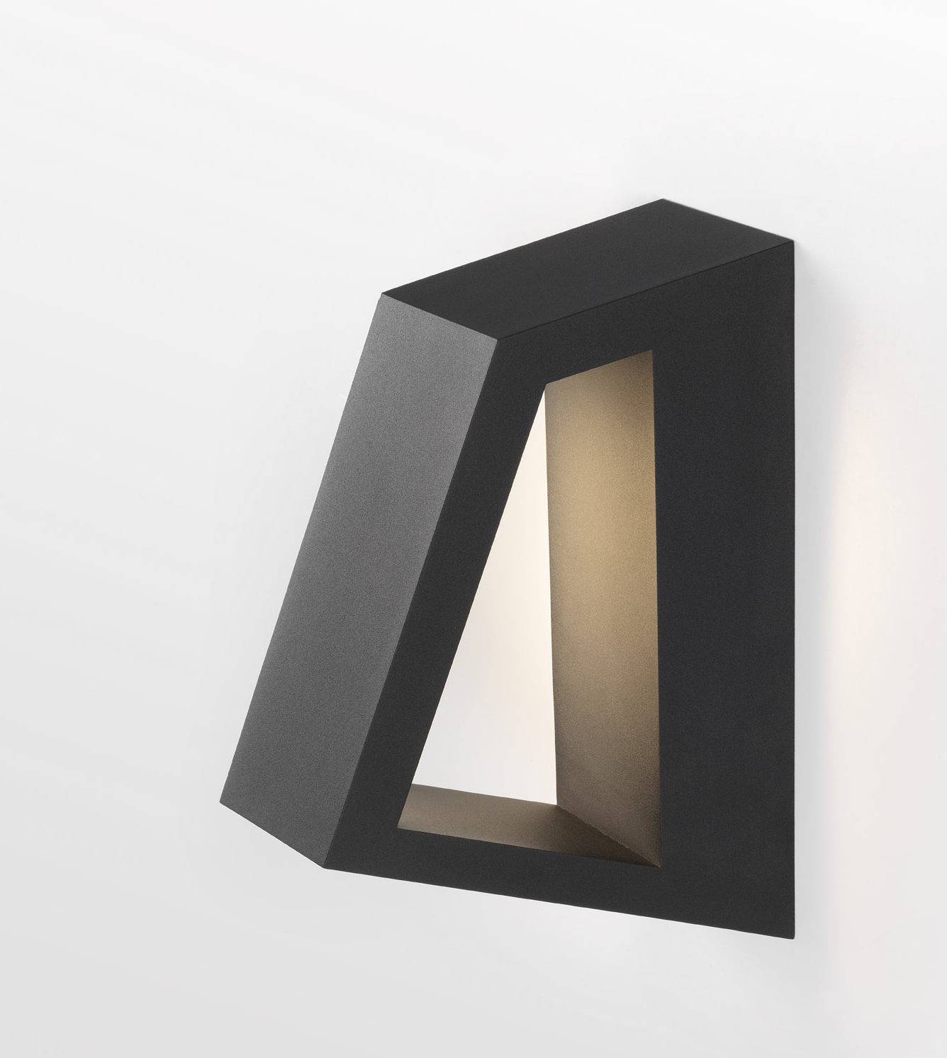
Wall mounting
Can be flipped around 180° without disassembling the wall plate

Slide 7
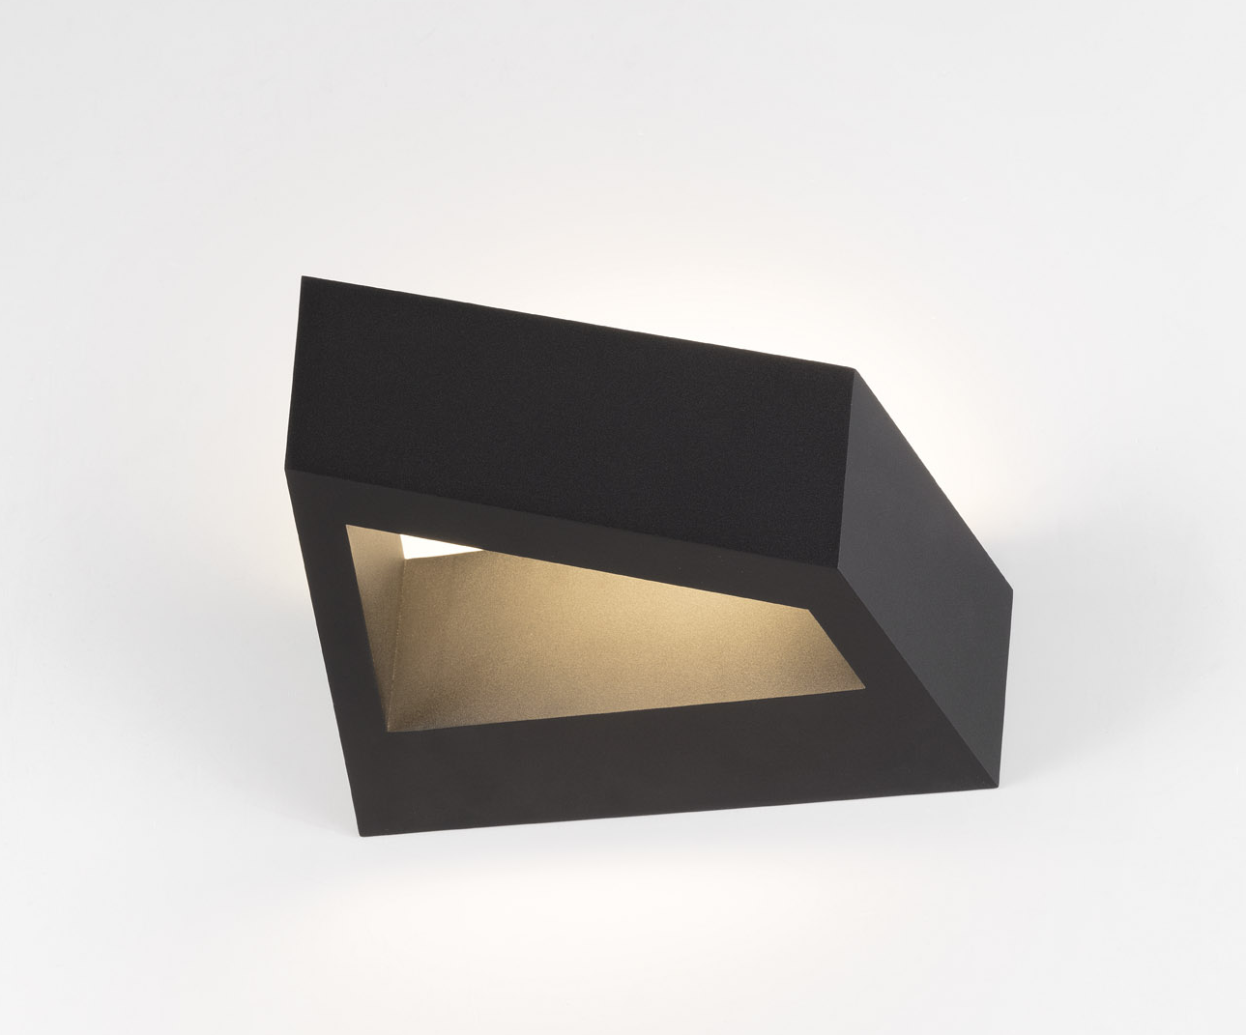
Colours

Slide 8
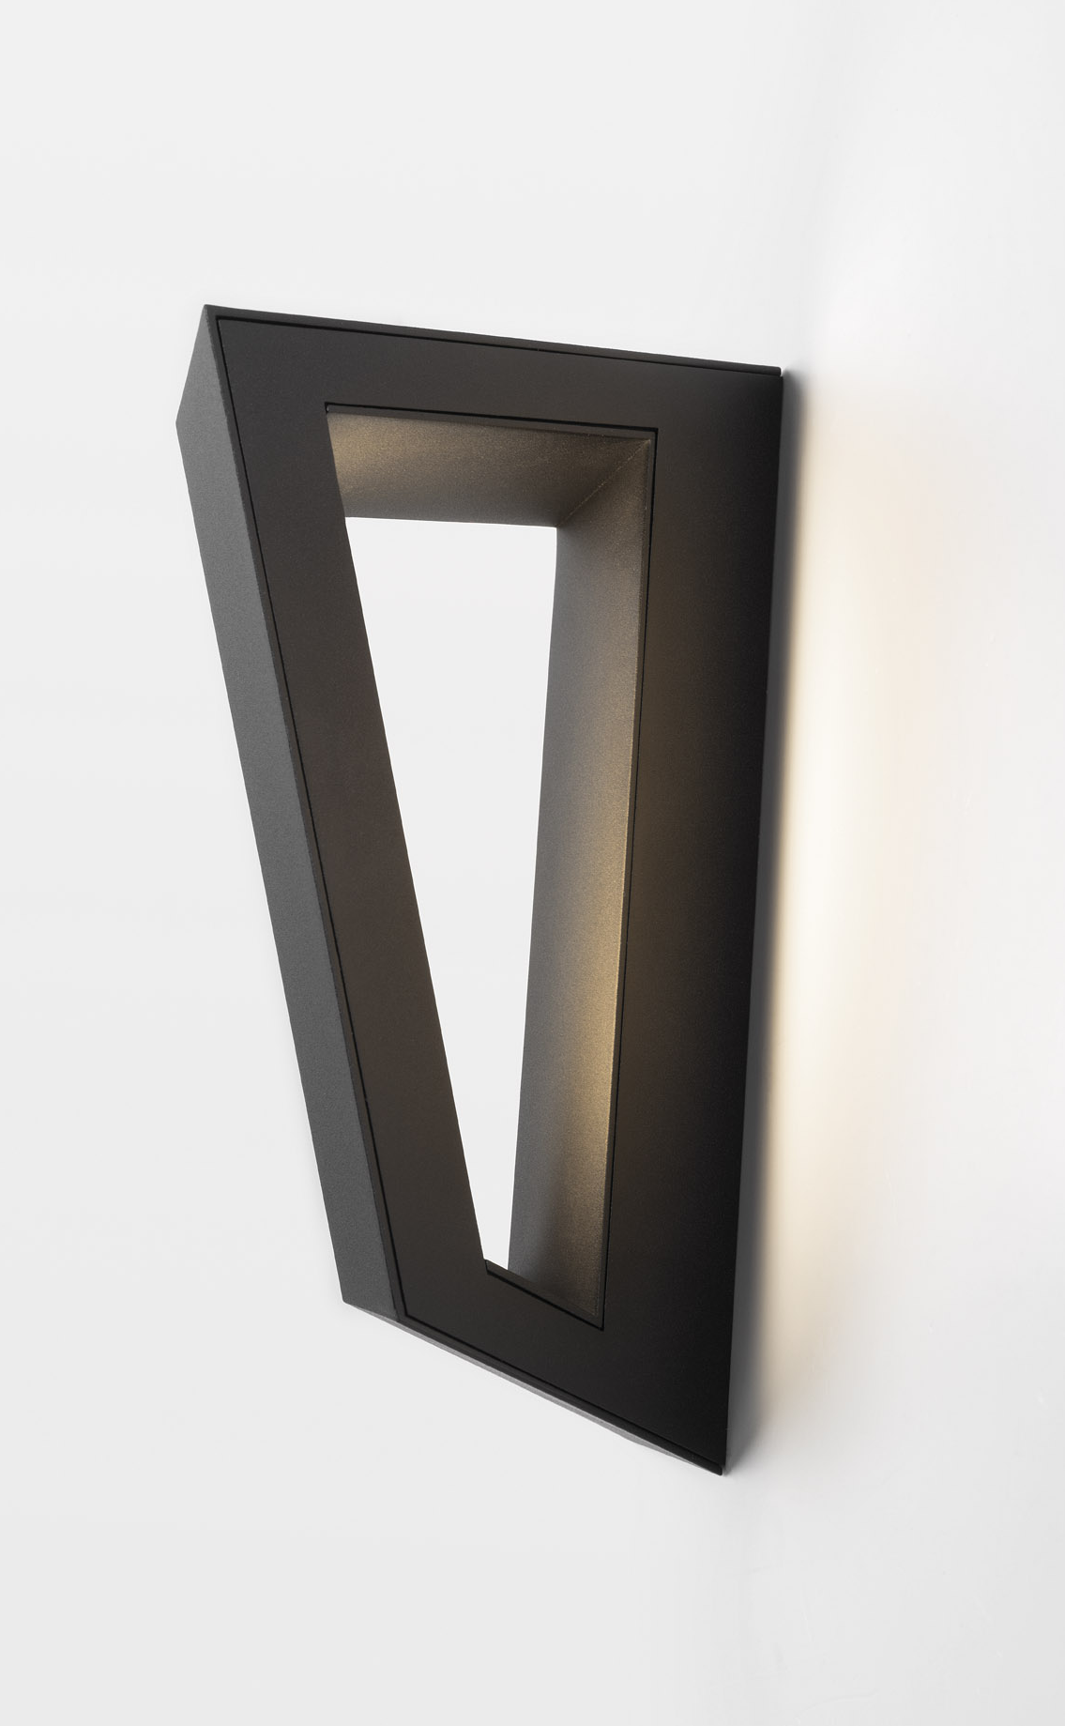
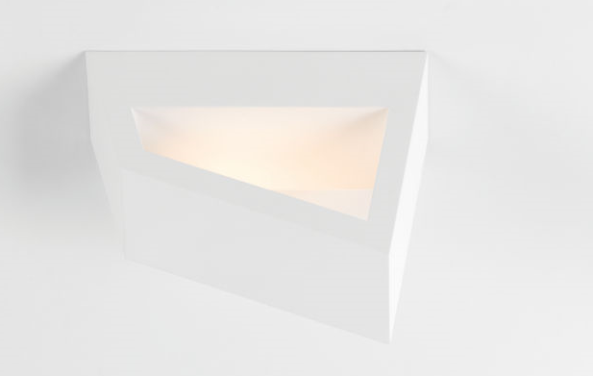
Design features
No visible screws due to magnetic cover plate
Thin design-gap visible along one side

Slide 9
Specifications

Slide 10
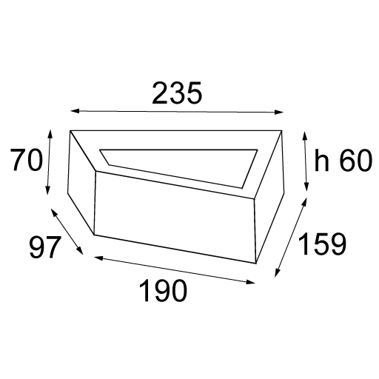

Bold
2700K – 3000K
CRI90+
818 lm⁽¹⁾
11 W⁽¹⁾
74 lm/W⁽¹⁾
Tre dim 1-10V/Pushdim
(1) 3000K, white struc
Always check our website for the most complete and up to date specifications!

Slide 11
DESIGN
ARCHITECTURAL STATEMENT
STRONG LINES
OBLIQUE SHAPE
MANIPULATED PERSPECTIVE
NO SCREWS VISIBLE
APPLICATION
HIGH END RESIDENTIAL
HOSPITALITY
AMBIENT LIGHT
HORIZONTAL OR VERTICAL
POSITIONING
TECHNOLOGY
HIGH QUALITY OF LIGHT
GEAR INTEGRATED
INDIRECT UP/DOWN LIGHTEFFECT
MAGNETIC COVERPLATE

Slide 12
Inspiration

Slide 13
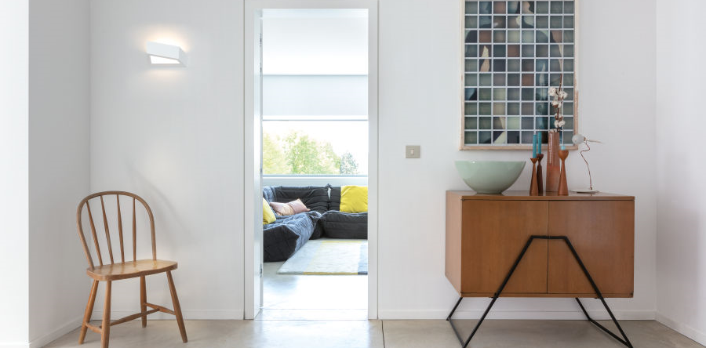

Slide 14
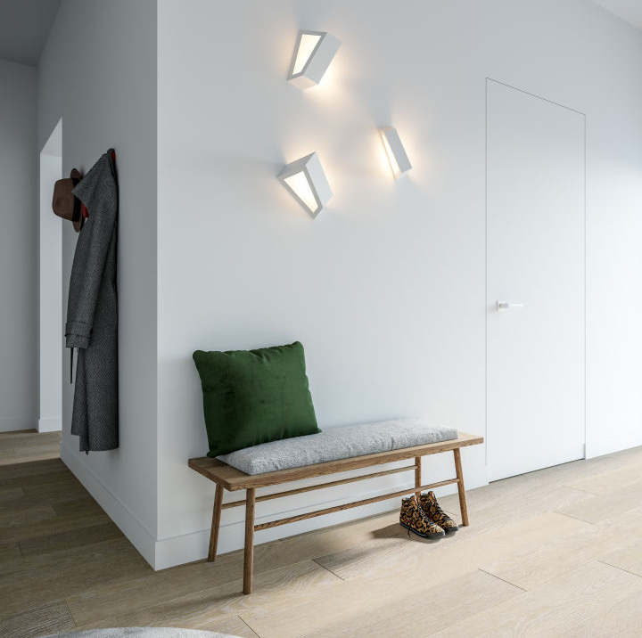
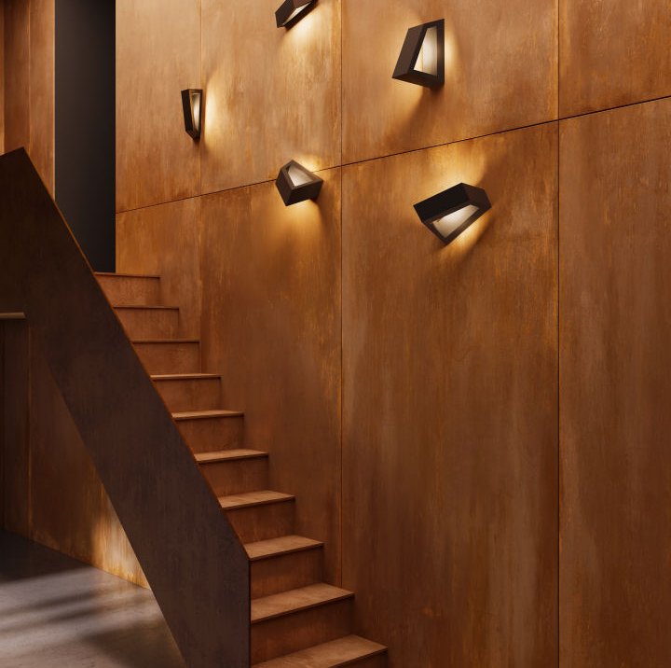

Slide 15
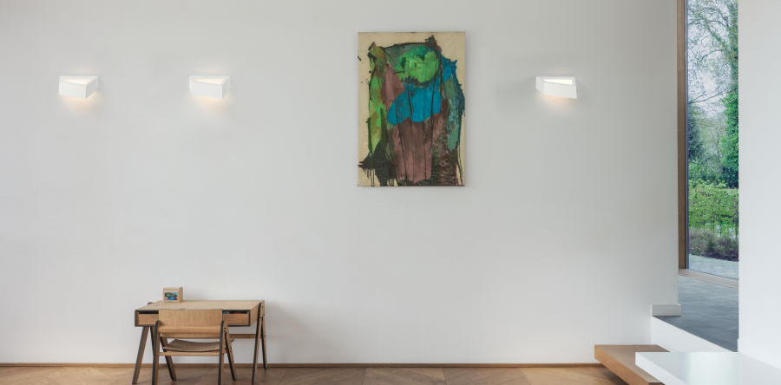

Slide 16
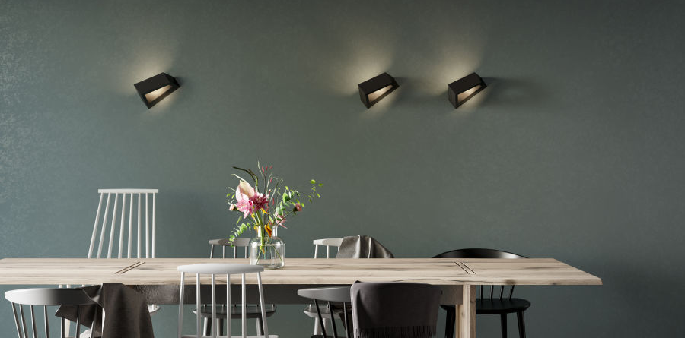

Slide 17
